Slide 1


Slide 2
Measurements of Marine Atmospheric Boundary Layer Dynamics using a Ship-based, Motion-stabilized, Doppler Lidar during the Dynamics of the Madden Julian Oscillation (DYNAMO) Experiment
Wm. Alan Brewer, Chris Fairall, R. J. Alvarez II, A. Weickmann, S. Sandberg, and M. Hardesty
Acknowledge : Bill Brown, Derek Coffman,
Langley Dewitt, and Simon de Szoeke
Funding through NOAA climate and ONR

Slide 3
Background : The Madden Julian Oscillation (MJO)
A global scale coupling between atmospheric circulation and tropical convection
A 30-60 day travelling pattern that can repeat & circle the globe.
Initiates in the Indian Ocean
Has an impact on the Monsoon, ENSO, Western North American Winter Precipitation

Slide 4
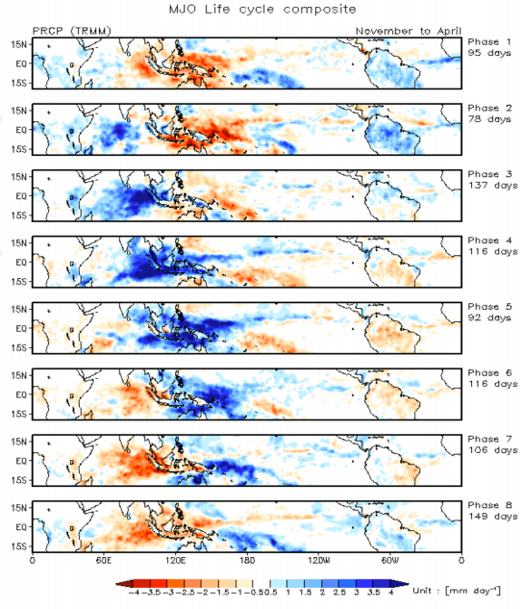
Background :
MJO Life Cycle Composite : Precipitation
30-60 day pattern
In the Indian Ocean and the Western Pacific, the MJO manifests as anomalous rainfall – enhanced and suppressed convection
Challenge : Characterize convection over large spatial and temporal scales
Several experiments across the Indian Ocean and Western Pacific (DYNAMO,CINDY,AMIE)
Sounding Network
Courtesy of Jon Gottschalck and Qin Zhang

Slide 5

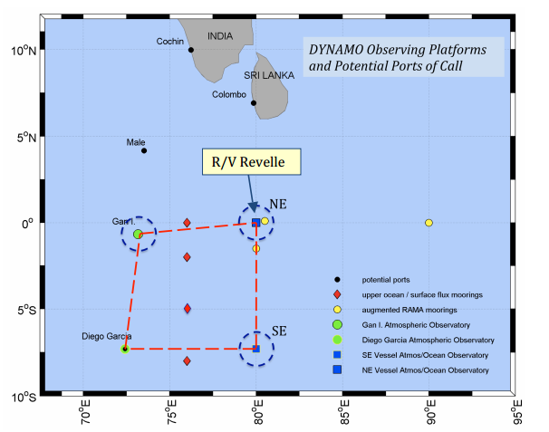
DYNAMO Dynamics of the Madden Julian Oscillation Observational array located in equatorial Indian Ocean to observe the initiation and propagation phases of the MJO Soundings and Radar to characterize the ocean and atmosphere Oct 2011 – Dec 2011

Slide 6
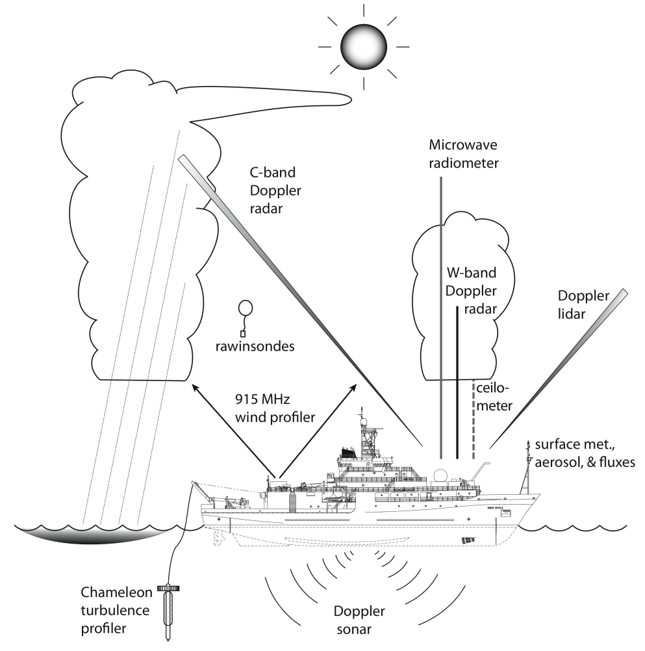
DYNAMO Dynamics of the Madden Julian Oscillation Suite of measurements on the Revelle to observe dynamics from subsurface thought marine atmospheric boundary layer
Doppler Lidar observations: Surface through lower Boundary Layer

Slide 7
Overview -
Instrument / measurement scheme
Horizontal wind profiles
Comparisons with other measurements
Comparison with similarity theory
Turbulence Profiles
Statistics for different convective regimes
Characterizing convective outflows
Summary

Slide 8
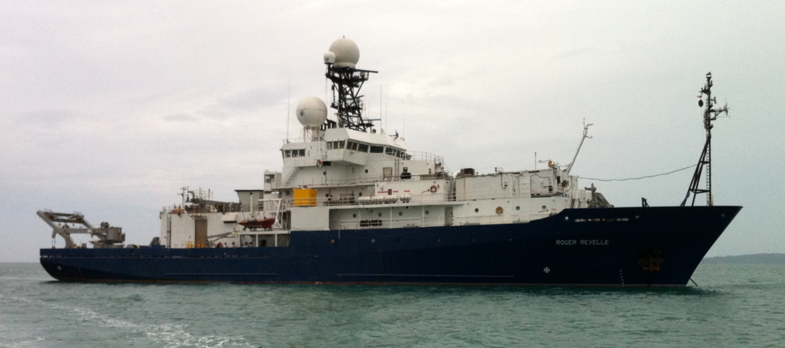
NOAA’s High Resolution Doppler Lidar (HRDL)
Mounted on the forward O2 deck of the RV Revelle
NOAA HRDL

Slide 9
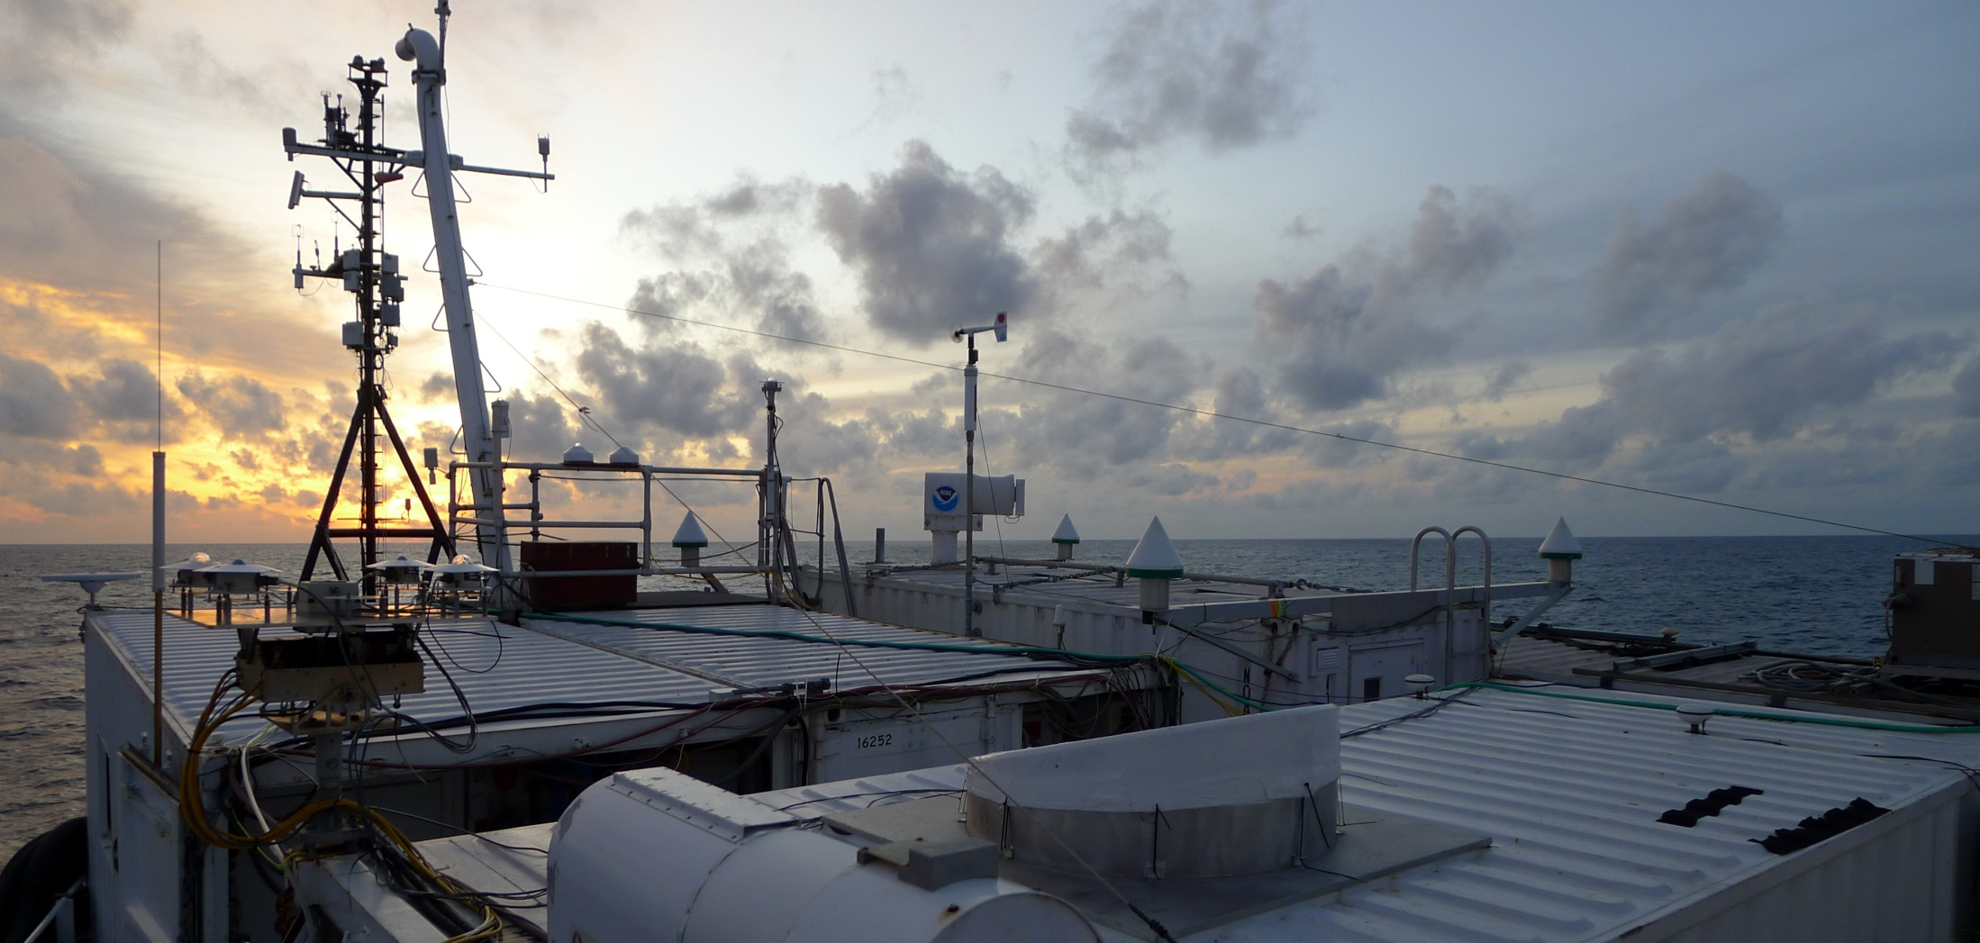
NOAA’s High Resolution Doppler Lidar (HRDL)
Mounted on the forward O2 deck of the RV Revelle
2 micron wavelength : invisible / eyesafe
Hemispheric Scanning / Motion Stabilized ≤ 0.5 degrees

Slide 10
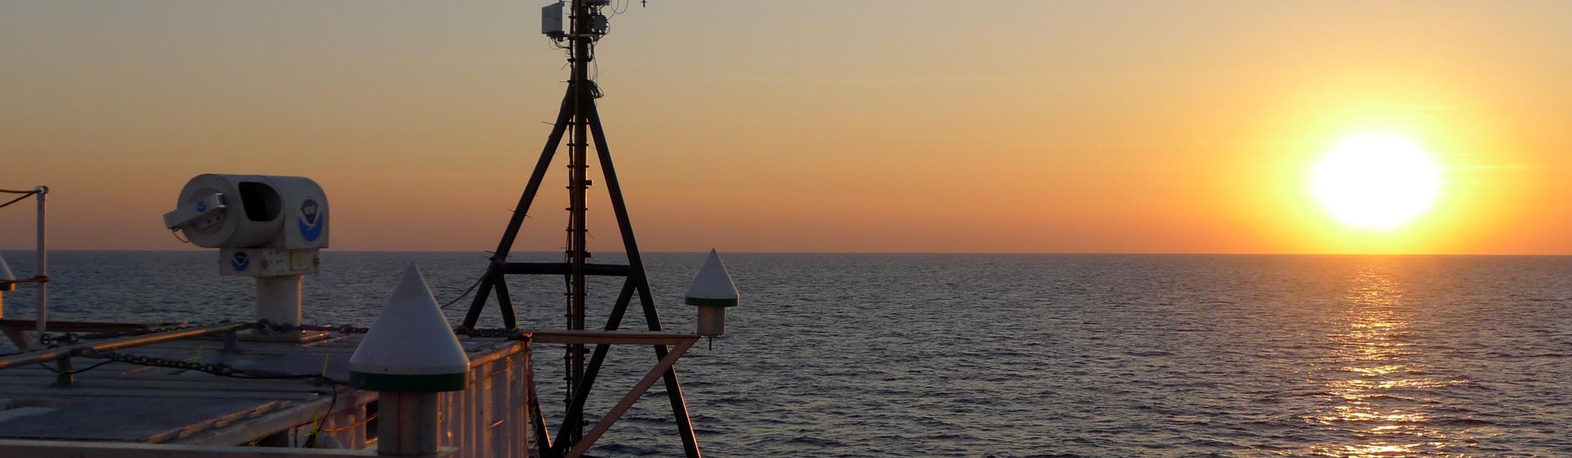
NOAA’s High Resolution Doppler Lidar (HRDL)
Mounted on the forward O2 deck of the RV Revelle
2 micron wavelength : invisible / eyesafe
Hemispheric Scanning / Motion Stabilized ≤ 0.5 degrees
Measures Radial Wind Speed and Aerosol Backscatter Intensity
30m along beam resolution, 2 Hz data rate
Typical coverage: 200m – 6km / vertically to cloudbase or the top of the aerosol layer & Cirrus clouds to 16km

Slide 11
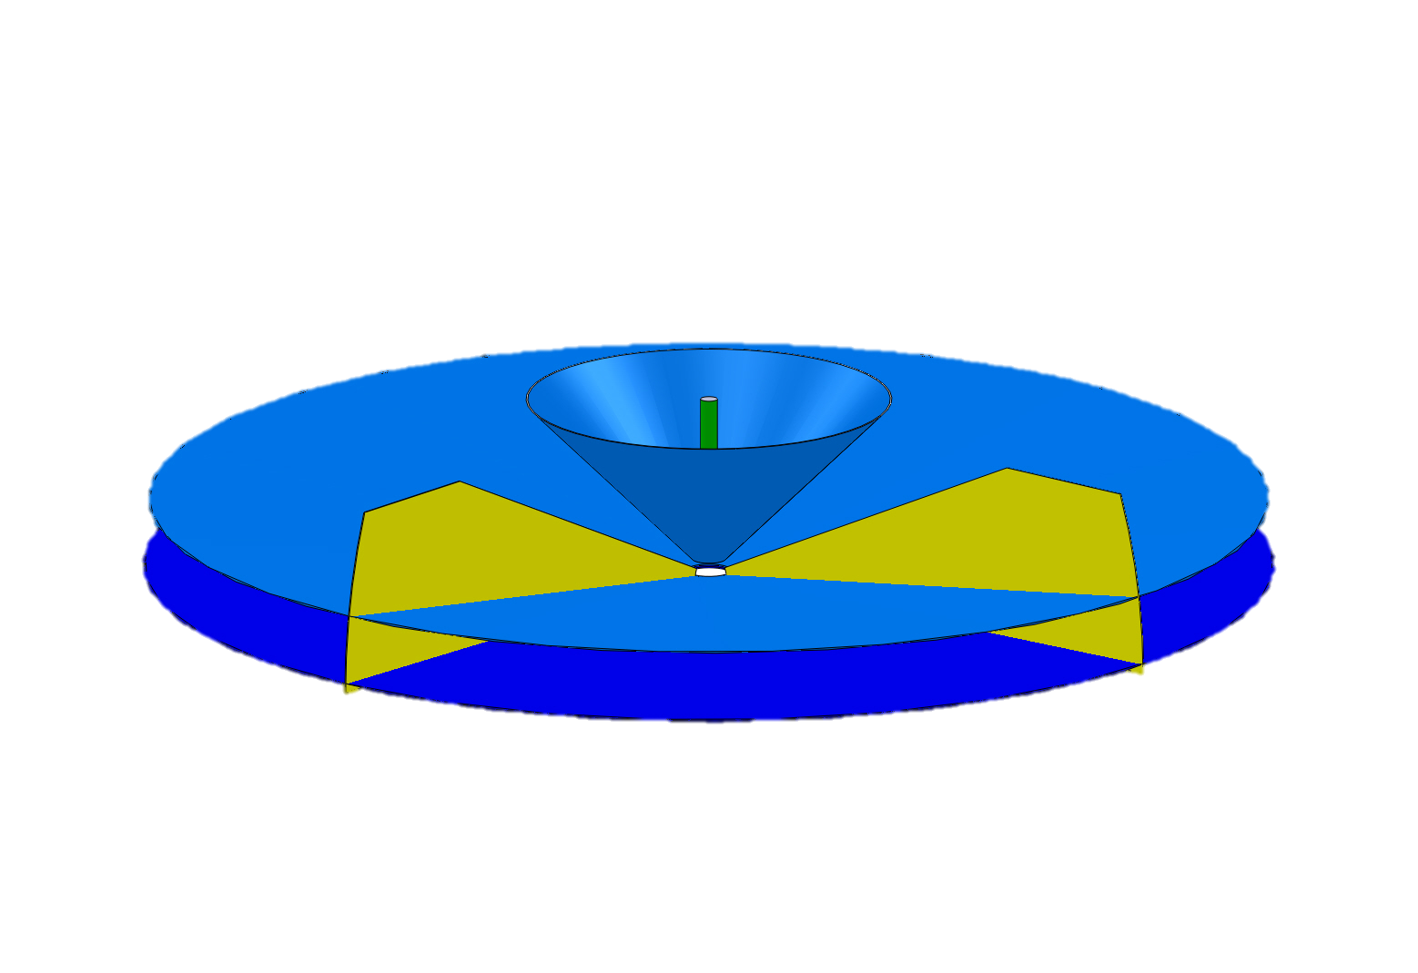
Repeating 20 minute scan sequence
0
Shallow PPI
High PPI
Horizontal and vertical scanning
Zenith stare
Sampling strategy: Continuous coverage and allow the features in the atmosphere to advect past.
Shallow RHI
10
Zenith
20
minutes

Slide 12
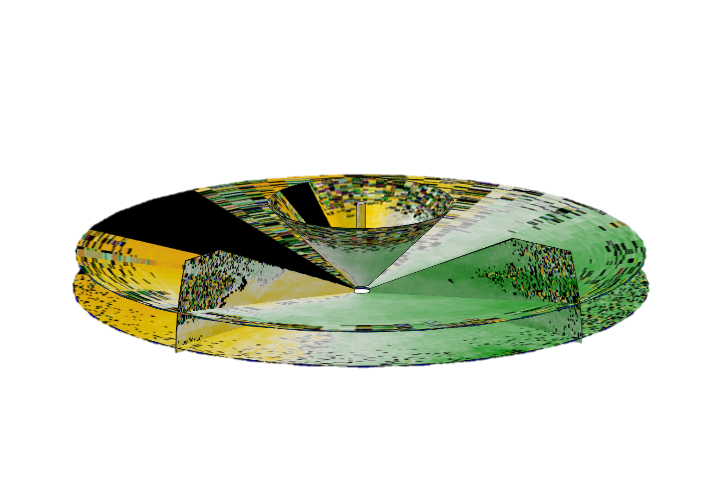
Repeating 20 minute scan sequence
0
Shallow PPI
High PPI
Horizontal and vertical scanning
Zenith stare
Sampling strategy: Continuous coverage and allow the features in the atmosphere to advect past.
Characterize the mean winds, turbulence, and spatially/temporally evolving wind field
Shallow RHI
10
Zenith
20
minutes

Slide 13
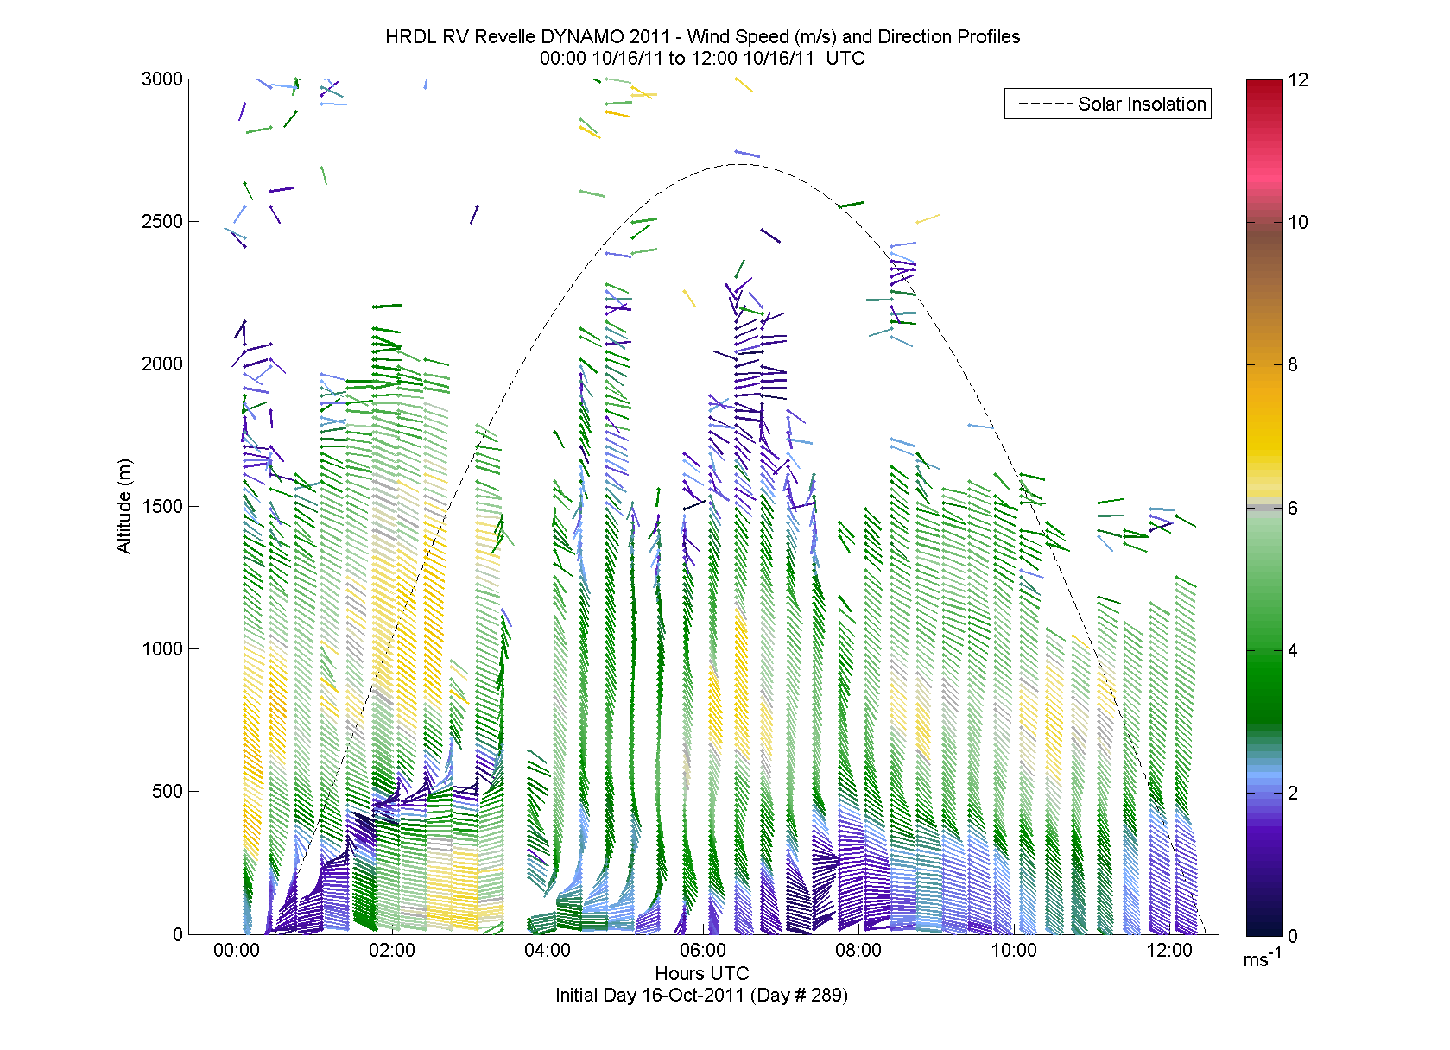
12 Hour Horizontal Wind Profiles
Continuous coverage every 20 mins from 5m up through top of aerosol layer or cloud base : 5-15m vertical resolution

Slide 14
12 Hour Horizontal Wind Profiles
Our interest : clear air dynamics in the lower boundary layer
Notes:
Here is the horizontal wind profiles for a 12 hour period during a day with a lot of structure. As we will show in the next slide, the 915 MHz profiler has issues with seaclutter below 1000m (the horizontal line) and the lower 200m is of particular interest when looking at air sea interaction.

Slide 15
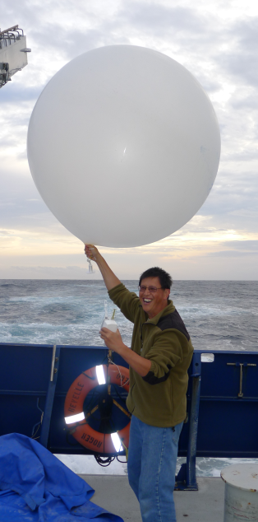
Comparing with other wind measurements made from the RV Revelle
NCAR Sondes (3hr)
NCAR 915 MHz Wind Profile (30min)
NOAA HRDL
(20min)
NOAA Sonic
(≈100Hz)

Slide 16
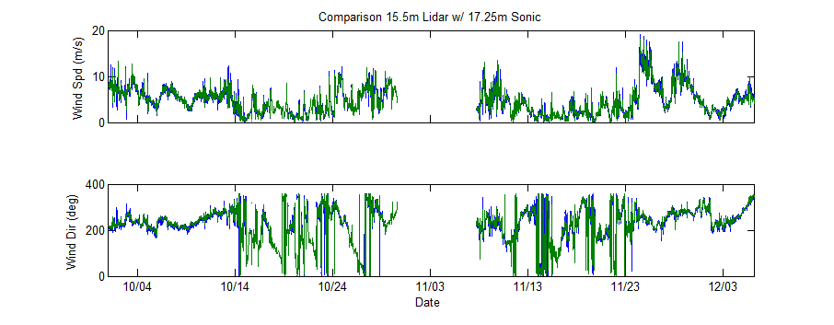
Compare HRDL winds with Sonic Anemometer
Limit relative wind direction to ± 90 degrees off the bow
Apply 3σ outlier rejection
Notes:
Here is the horizontal wind profiles for a 12 hour period during a day with a lot of structure. As we will show in the next slide, the 915 MHz profiler has issues with seaclutter below 1000m (the horizontal line) and the lower 200m is of particular interest when looking at air sea interaction.

Slide 17
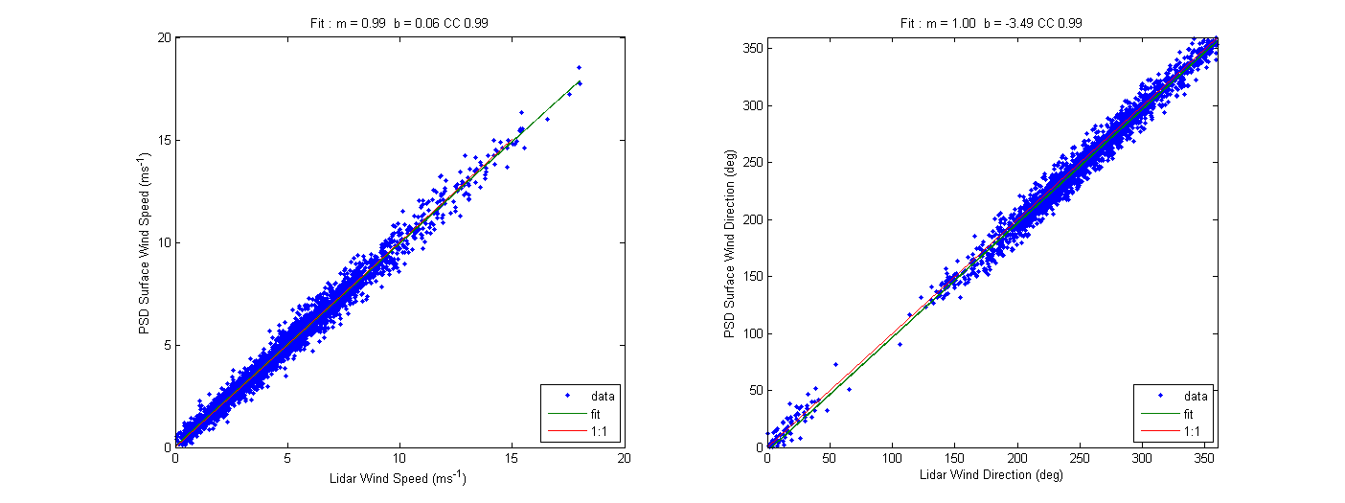
Compare HRDL winds with Sonic Anemometer
Wind Speed
Wind Direction
Sonic (m/s)
Sonic (deg)
Lidar (m/s)
Lidar (deg)
 | Speed | Direction
Slope | 0.99 | 1.00
Offset | 0.06 (m/s) | -3.49 (deg)
Corr Coef | 0.99 | 0.99
Comparison at approx 16m above sea surface
Notes:
Here is the horizontal wind profiles for a 12 hour period during a day with a lot of structure. As we will show in the next slide, the 915 MHz profiler has issues with seaclutter below 1000m (the horizontal line) and the lower 200m is of particular interest when looking at air sea interaction.

Slide 18
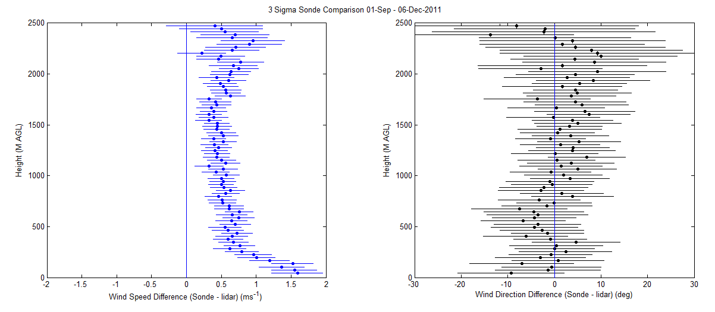
Lidar – Sonde Comparison
Height (m AGL)
Height (m AGL)
Wind speed Diff (Sonde–Lidar) (m/s) Wind Direction Diff (Sonde–Lidar) (deg)
For all 3hr Sonde profiles Legs 2 & 3 (RAW/UNPROCESSED)
Form mean(Sonde - Lidar) ± 3σ_{m} at every height
Sonde wind speeds are 0.5 m/s higher than lidar (> 350m), increases to 1.5 m/s at surface
This offset structure is consistent with a known unspooling/pendulum effect. NCAR is post processing Sonde data.

Slide 19
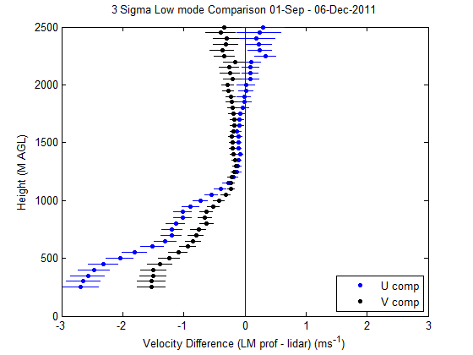
Lidar – 915 MHz Wind Profiler U and V Comparison
Height (m AGL)
Wind speed Diff (LM 915 MHz–Lidar) (m/s)
Apply same comparison with RAW/UNPROCESSED, low mode 915MHz wind profiler data: mean(lmWP - Lidar) ± 3σ_{m} at every height
Wind profiler is sensitive to seaclutter in lower gates
Comparison shows that U & V data are impacted up to a height of 1.1 km
NCAR is applying processing techniques which will improve the Wind Profiler data.

Slide 20
Comparison to Similarity Theory

Slide 21
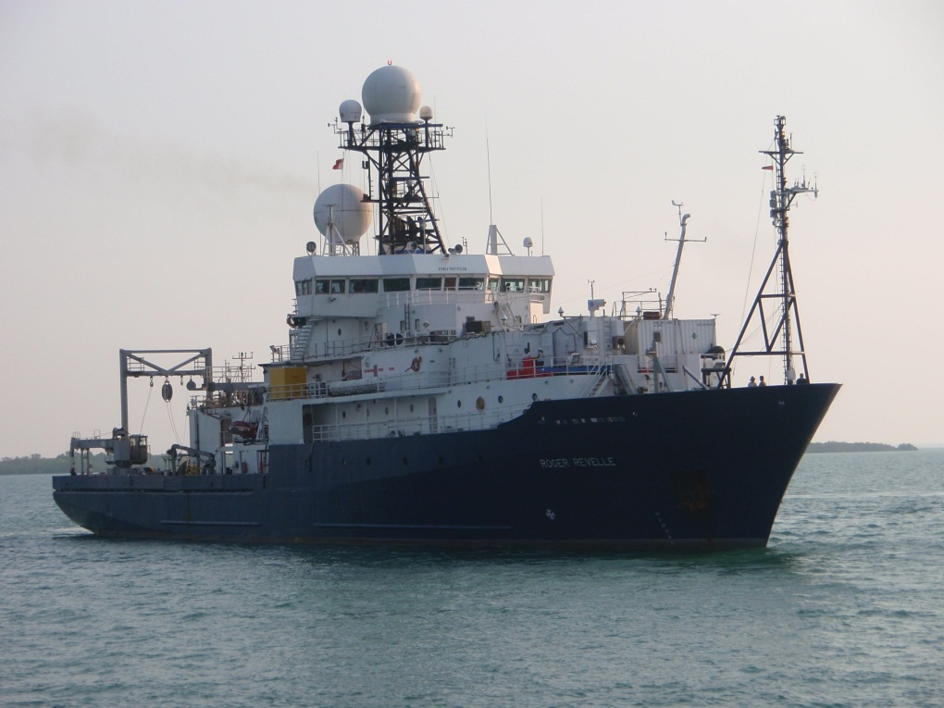
Winds in the lower 100m are used to compare to those predicted from similarity theory
u*=friction velocity, L= Monin Obukhov length, z_{o}=roughness: all 3 computed using COARE30 bulk flux algorithm.
Z=height above the surface
= MO dimensionless profile function (also from COARE30)
The sonic is at 18 m height; wind values were computed at 15, 30, 75, and 100 m to correspond to lidar wind height bins
Revelle at sea. Sonic anemometer is on the jackstaff on the bow. Lidar is in a container on the forward second deck of the ship. Sonic wind speeds were corrected for flow distortion by the ship’s structure.

Slide 22
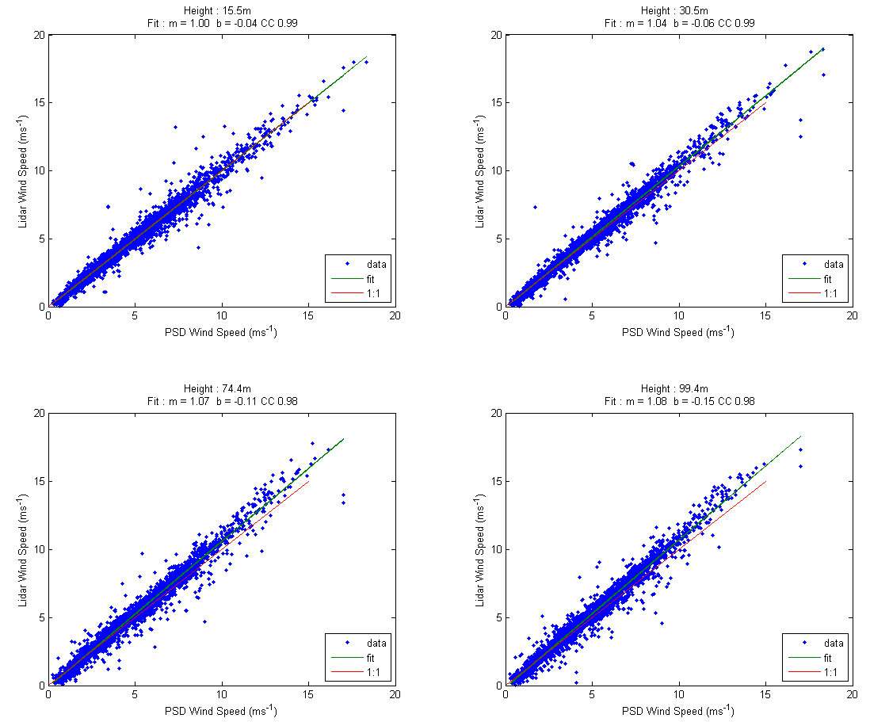
Compare surface winds to Lidar winds at 30m,75m,100m
surface (15m)
m = 1.00
30m
m = 1.04
75m
m = 1.07
100m
m = 1.08

Slide 23
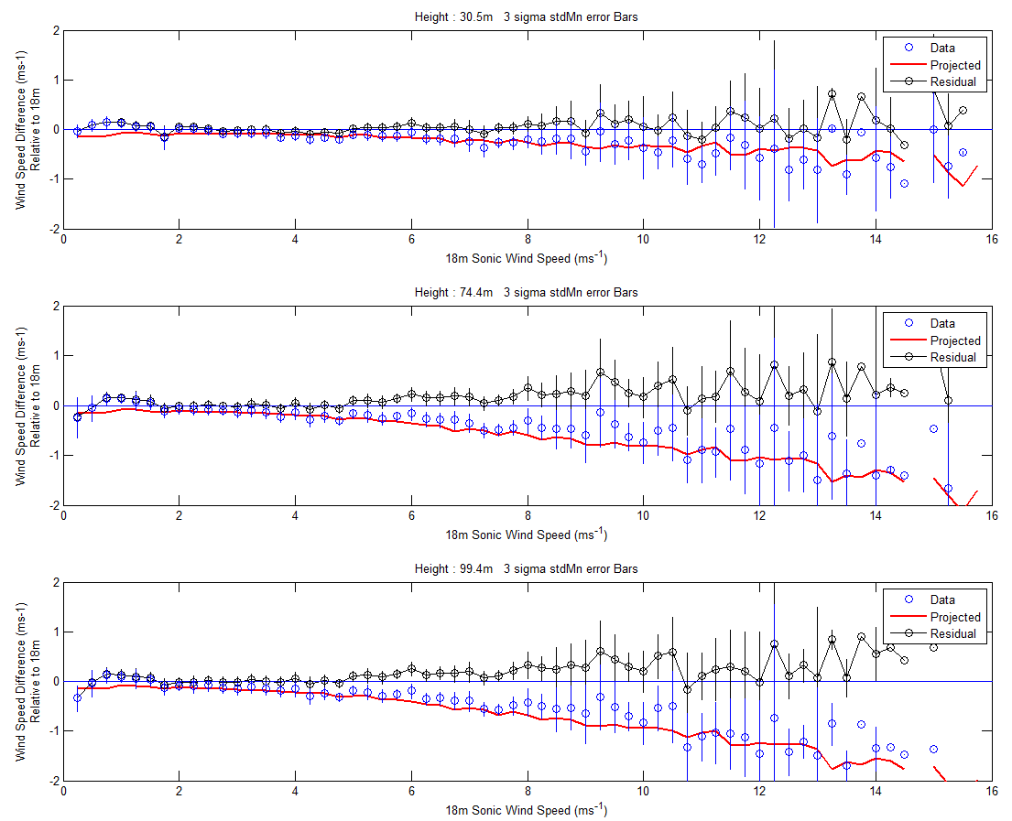
Compare similarity winds to Lidar winds at 30m,75m,100m
Residual Wind Speed: surface – (lidar or theory)
Surface (15m) Wind Speed

Slide 24
HRDL Turbulence Measurements
Notes:
Here is the horizontal wind profiles for a 12 hour period during a day with a lot of structure. As we will show in the next slide, the 915 MHz profiler has issues with seaclutter below 1000m (the horizontal line) and the lower 200m is of particular interest when looking at air sea interaction.

Slide 25
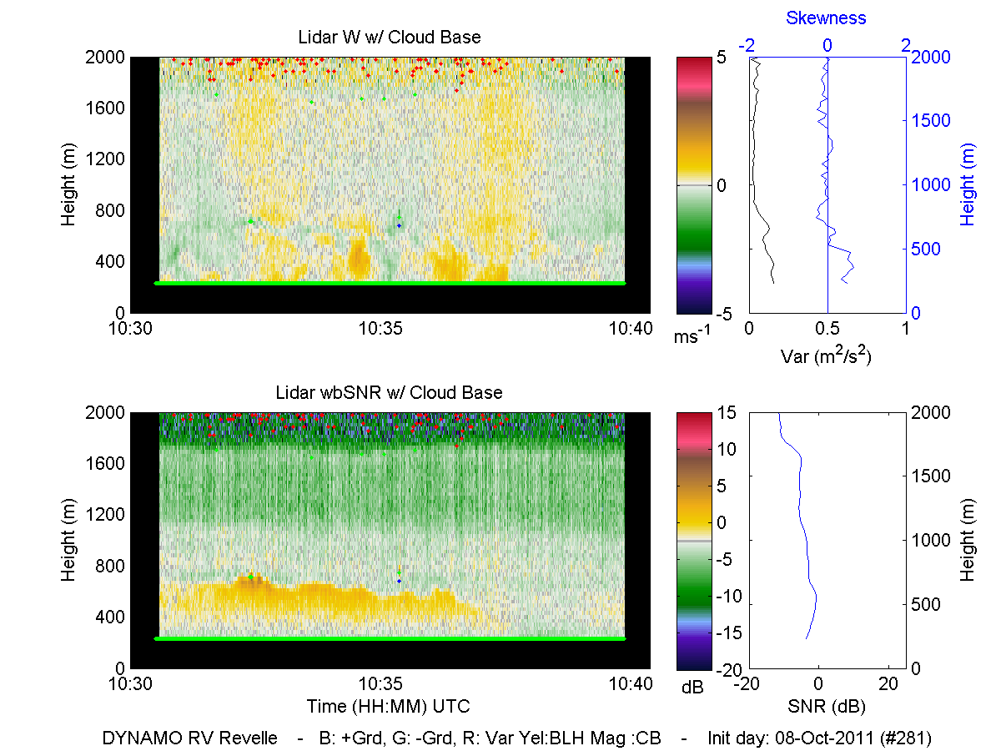
Vertical Velocities : Temporal variability
Form profiles of vertical velocity variance and skewness
Interpolate from minimum height to 15m using ship based Sonic Measurements (w’²)

Slide 26
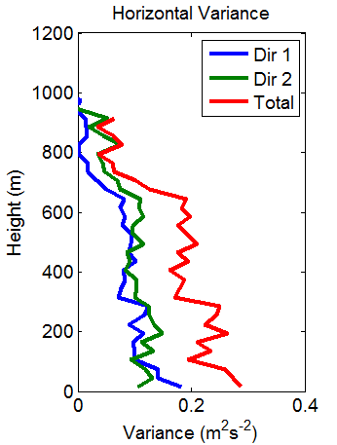
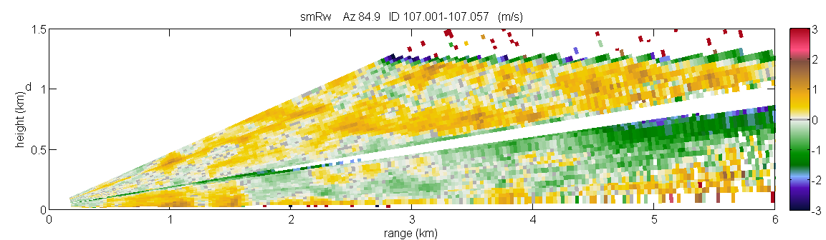
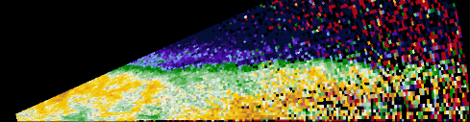
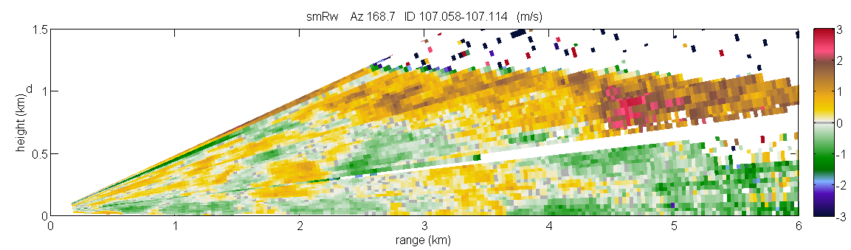
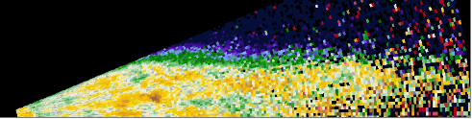
Horizontal Velocities : Spatial variability
Horizontal Velocity (ms⁻¹)
3
0
-3
3
0
-3
1.5
0
0 1 2 3 4 5 6
Height (km) Height (km)
1.5
0
0 1 2 3 4 5 6
Range (km)
One minute to form horizontal variance profiles, cover from the sea surface though cloud base. Samples scales of 30m – 6km.

Slide 27
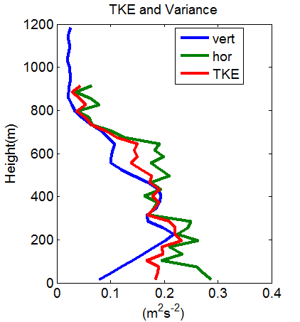
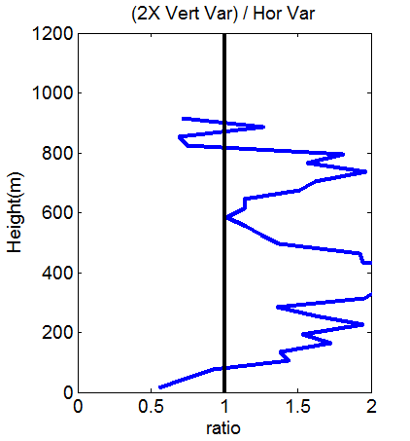
TKE and Variance
Isotropy Ratio
Vertical motion dominates
Horizontal motion dominates
The Isotropy ratio is one for isotropic turbulence

Slide 28
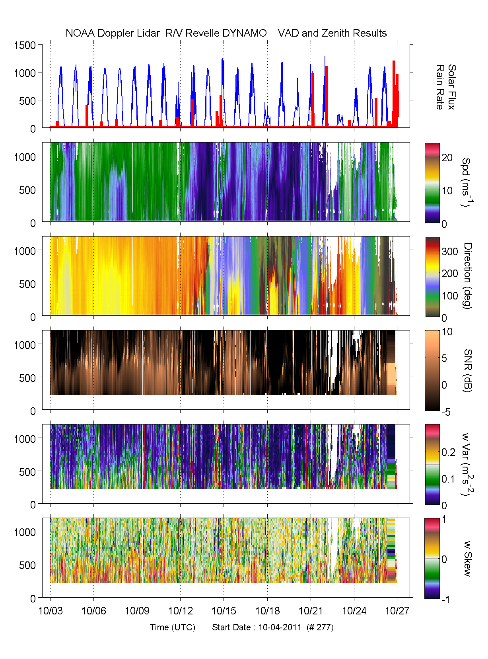
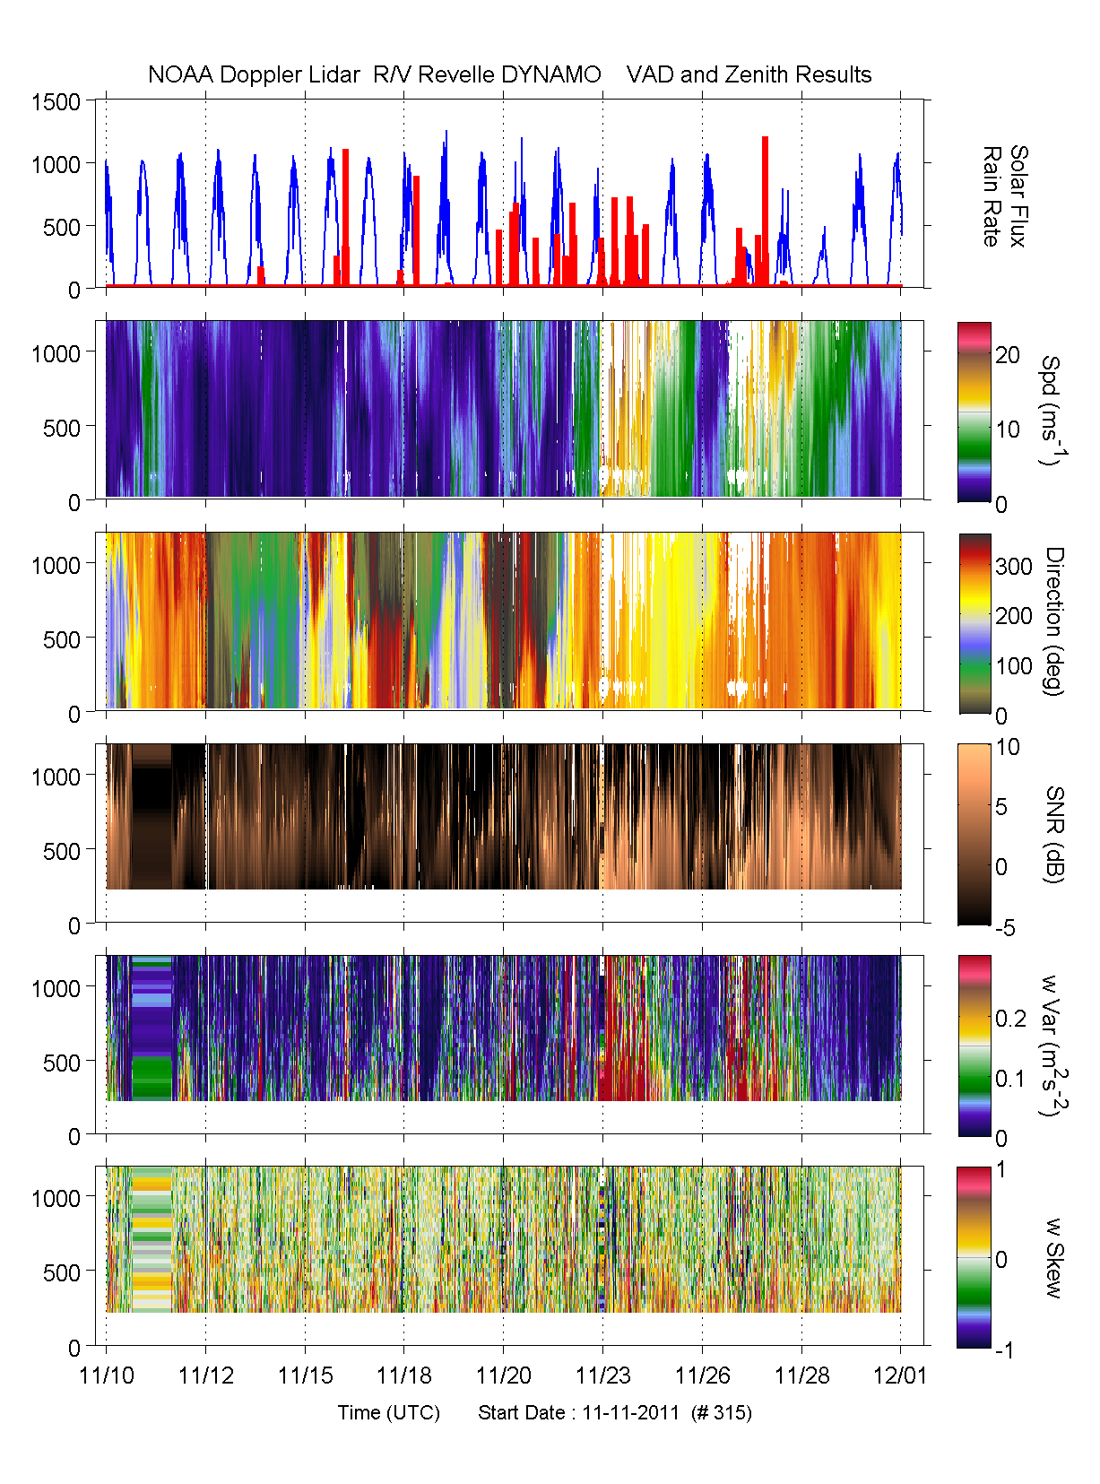
Leg 2 Leg 3

Slide 29
Statistics for different convective regimes
Notes:
Here is the horizontal wind profiles for a 12 hour period during a day with a lot of structure. As we will show in the next slide, the 915 MHz profiler has issues with seaclutter below 1000m (the horizontal line) and the lower 200m is of particular interest when looking at air sea interaction.

Slide 30
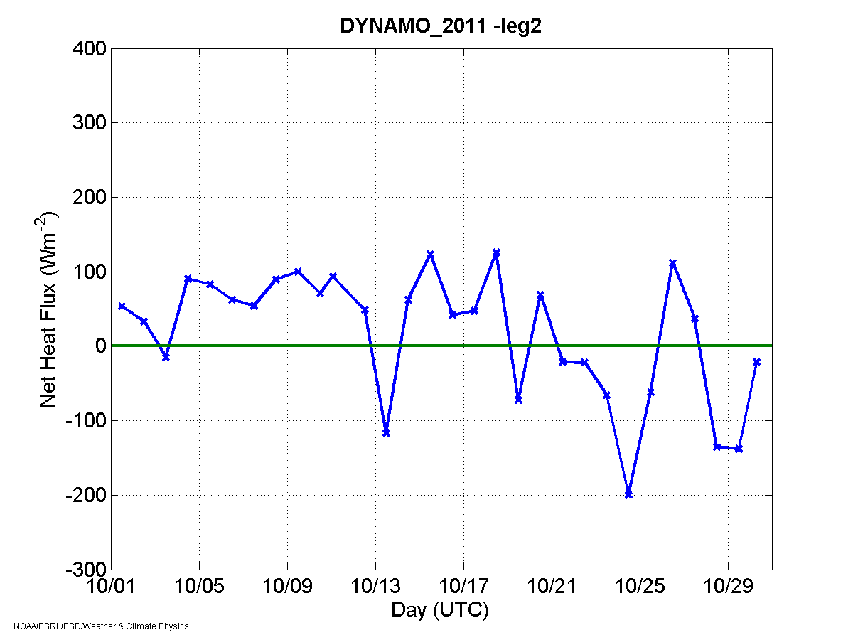
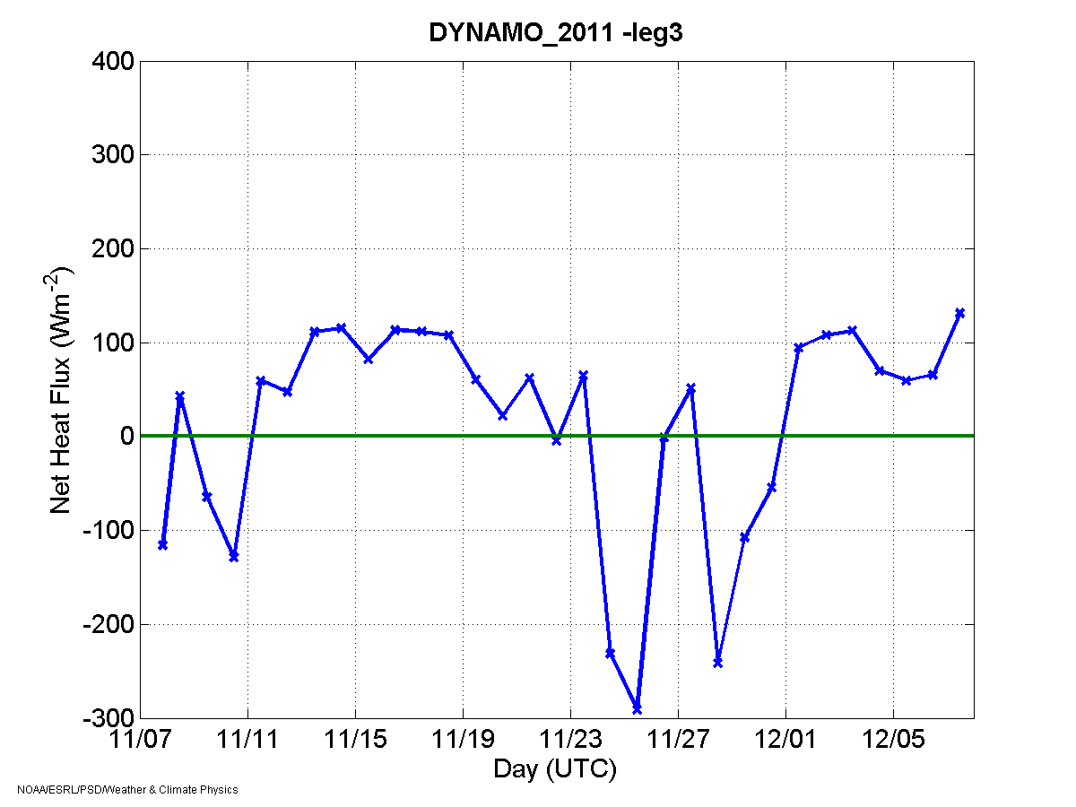
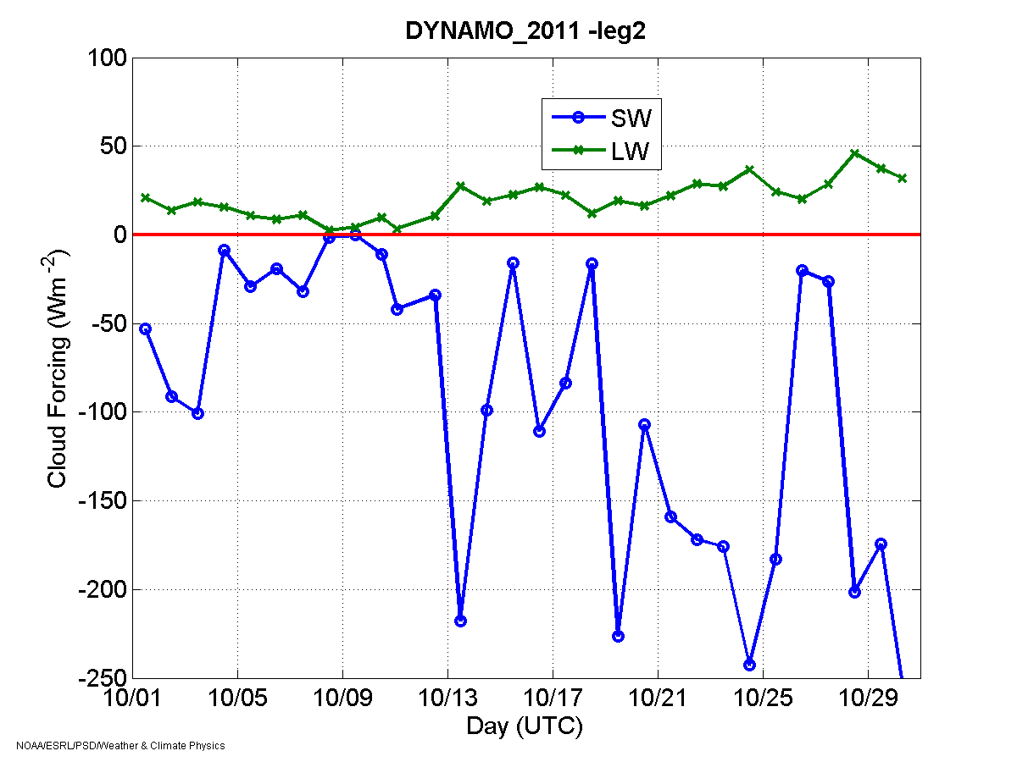
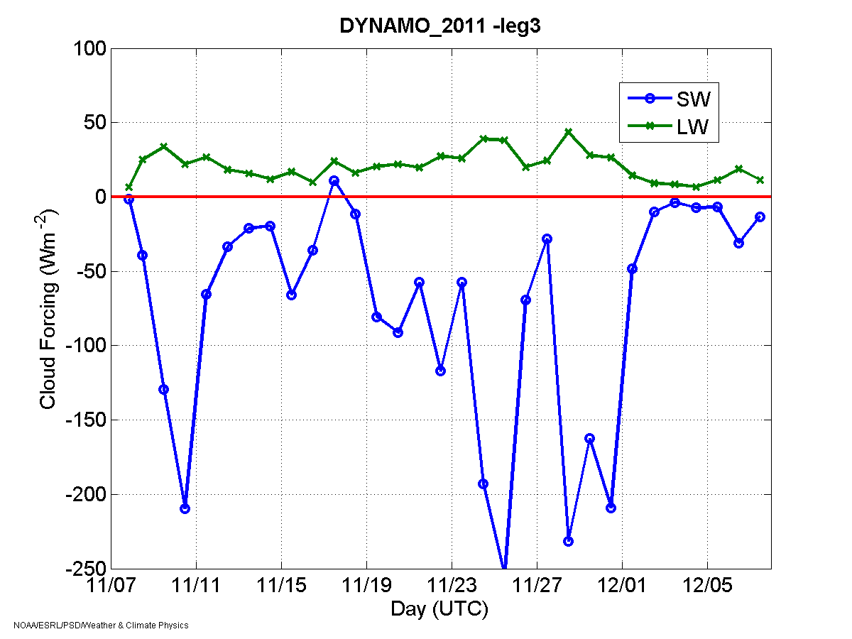
20 days
23 days
Net Heat Flux (Wm⁻²)
16 days
Combined metric threshold & variability
Maintain a regime for several days
Cloud Forcing (Wm⁻²)
Regimes
Suppressed
Disturbed
MJO

Slide 31
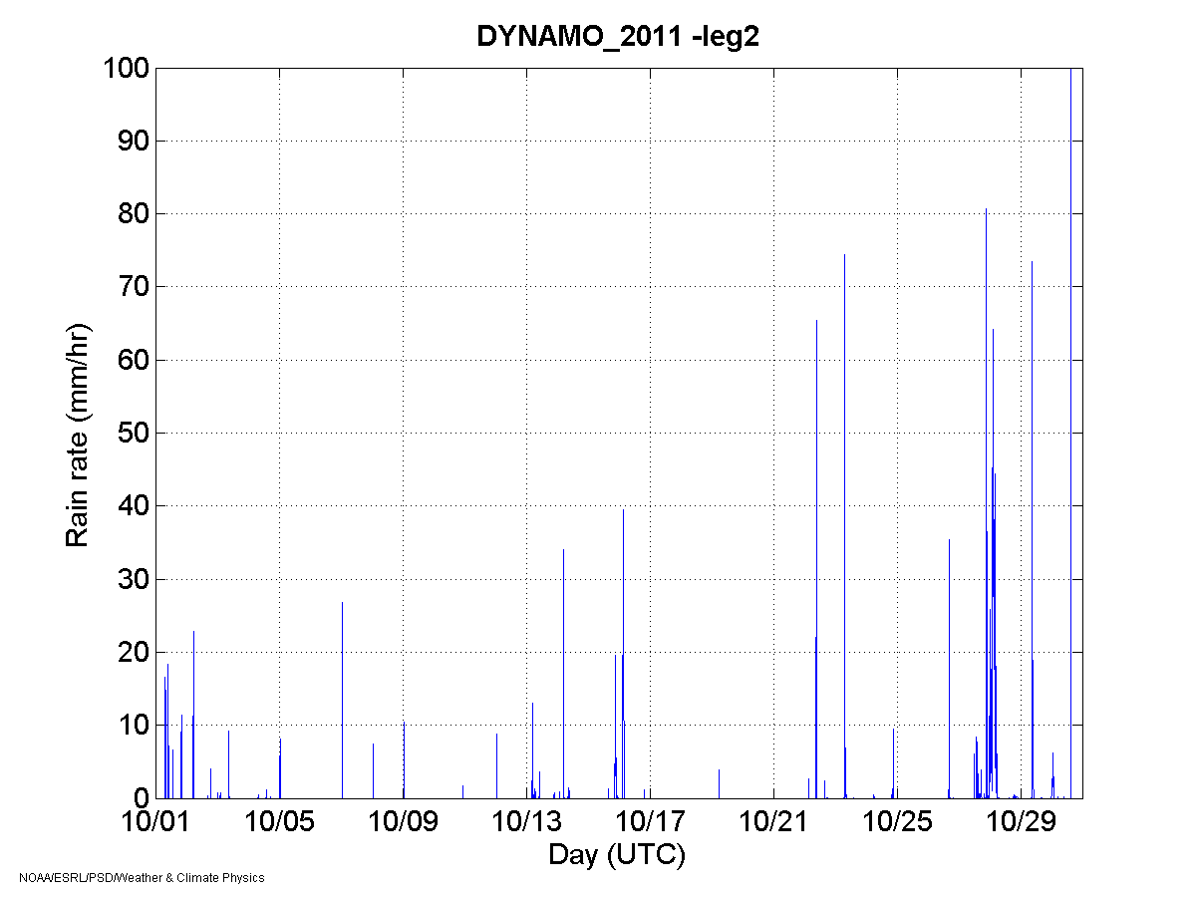
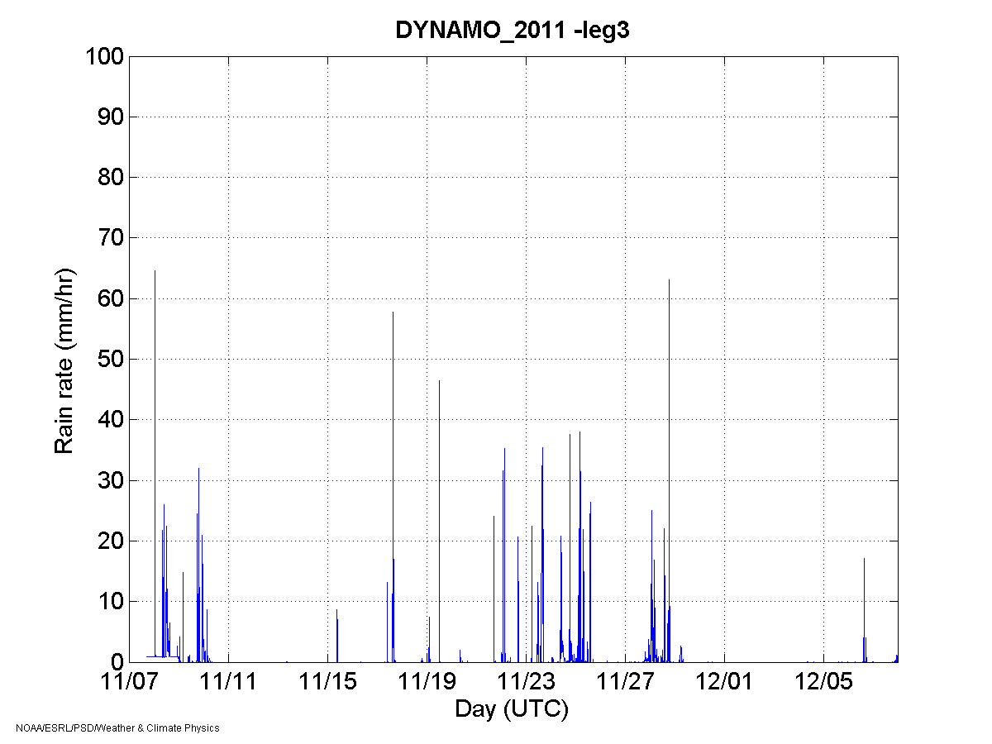
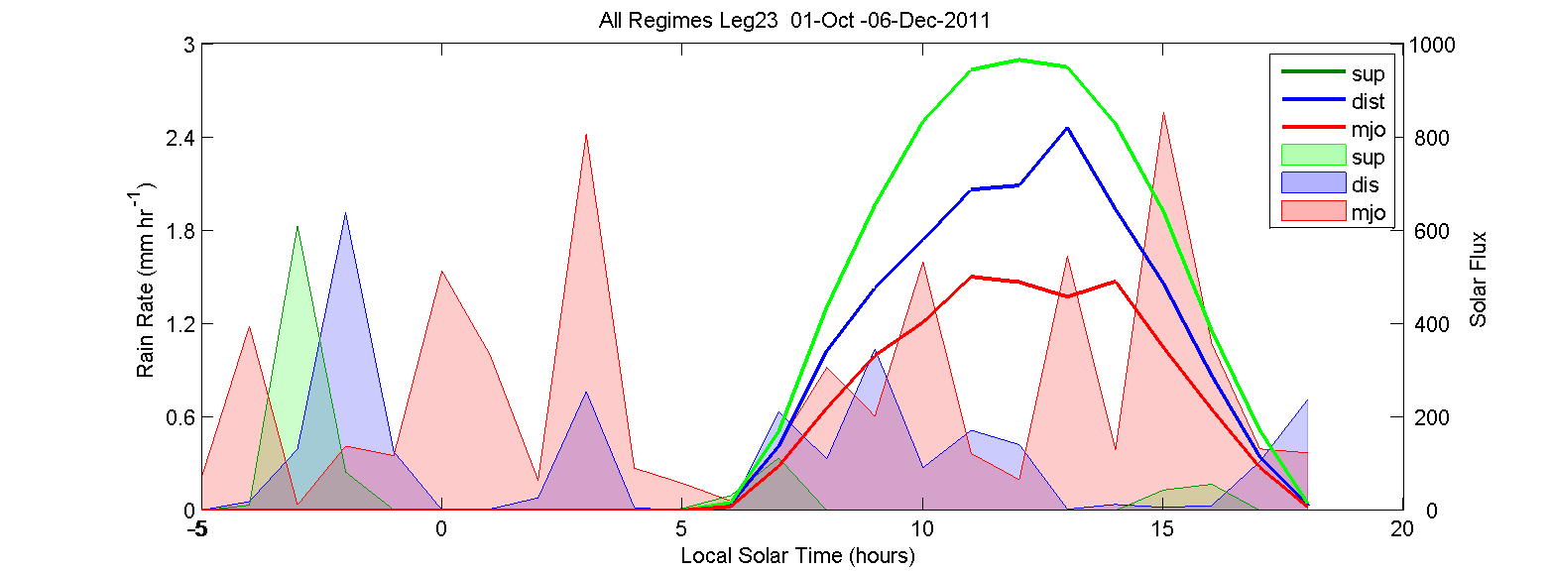
20 days
23 days
Rain Rate (mmHr⁻¹)
16 days
Rain Rate (mmHr⁻¹)
Rel Area
15.5%
43.0%
1
Regimes
Suppressed
Disturbed
MJO
Notes:
276, 765, 1486 mm
18.6%,51.5%, 100%

Slide 32
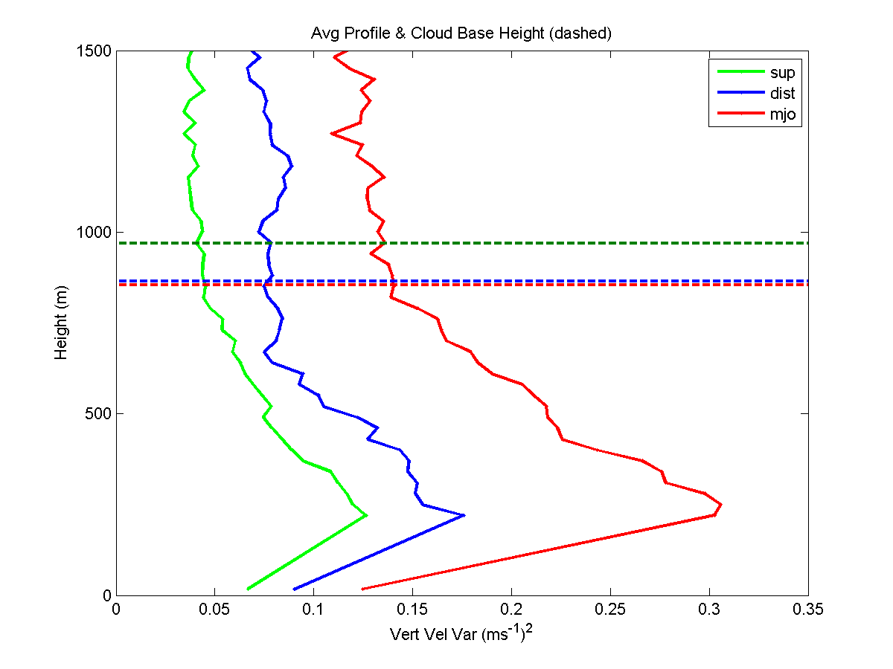
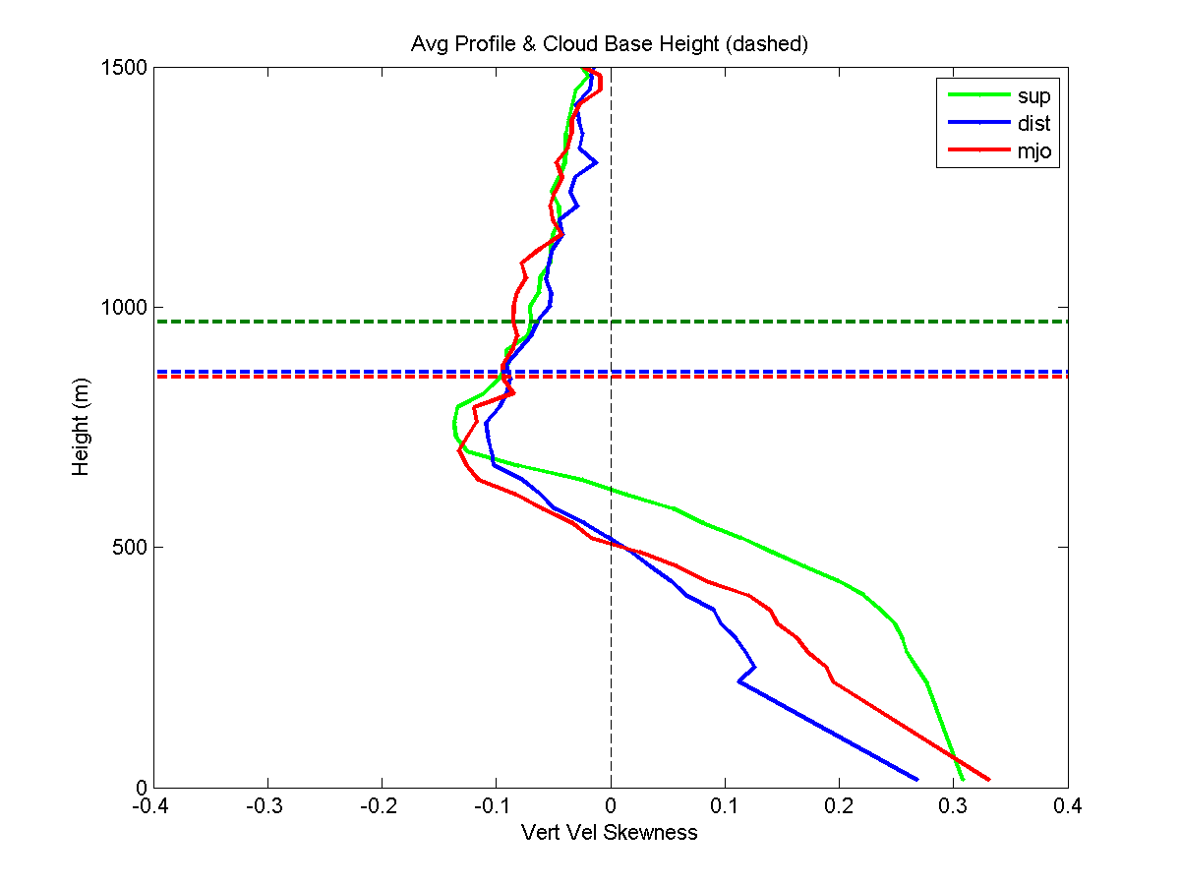
w Var & Skew
Ceilo Cloud Base
Vert Var (ms⁻²)
Skewness

Slide 33
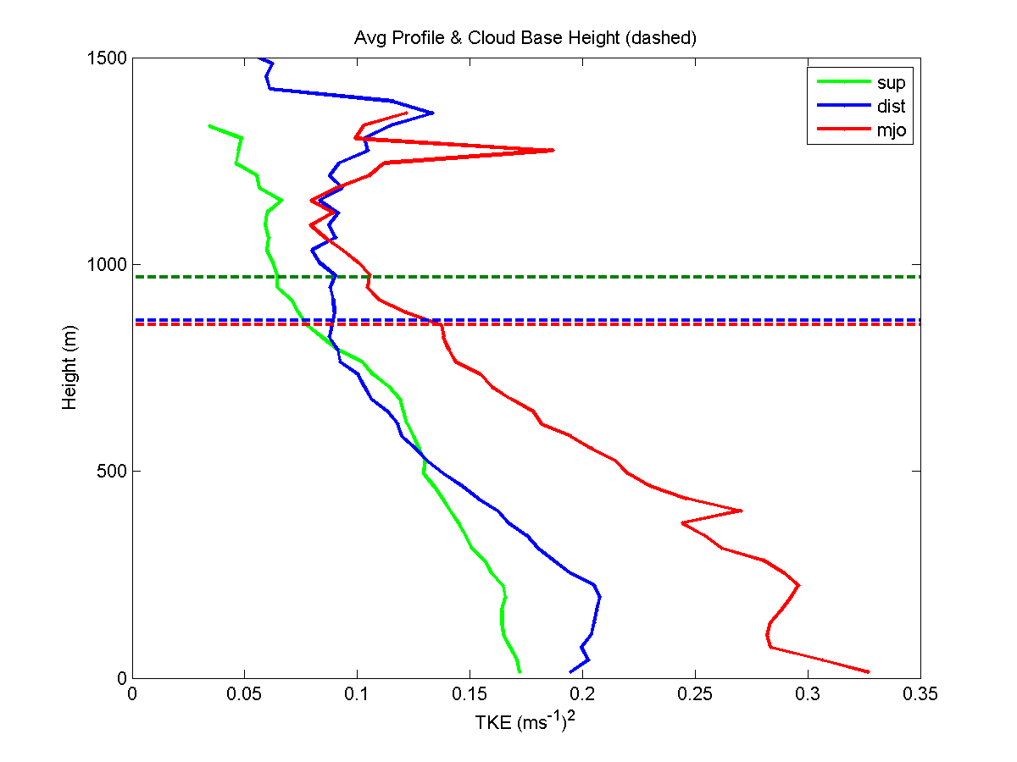
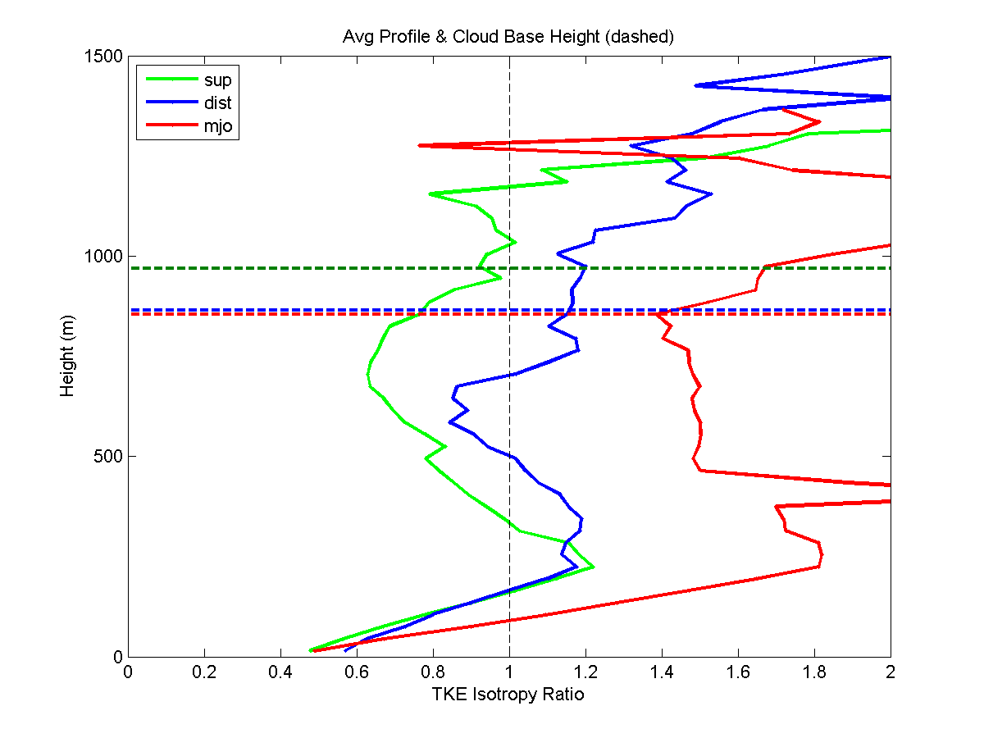
TKE & Isotropy Ratio
Ceilo Cloud Base
TKE (ms⁻¹) ²
Isotropy Ratio

Slide 34
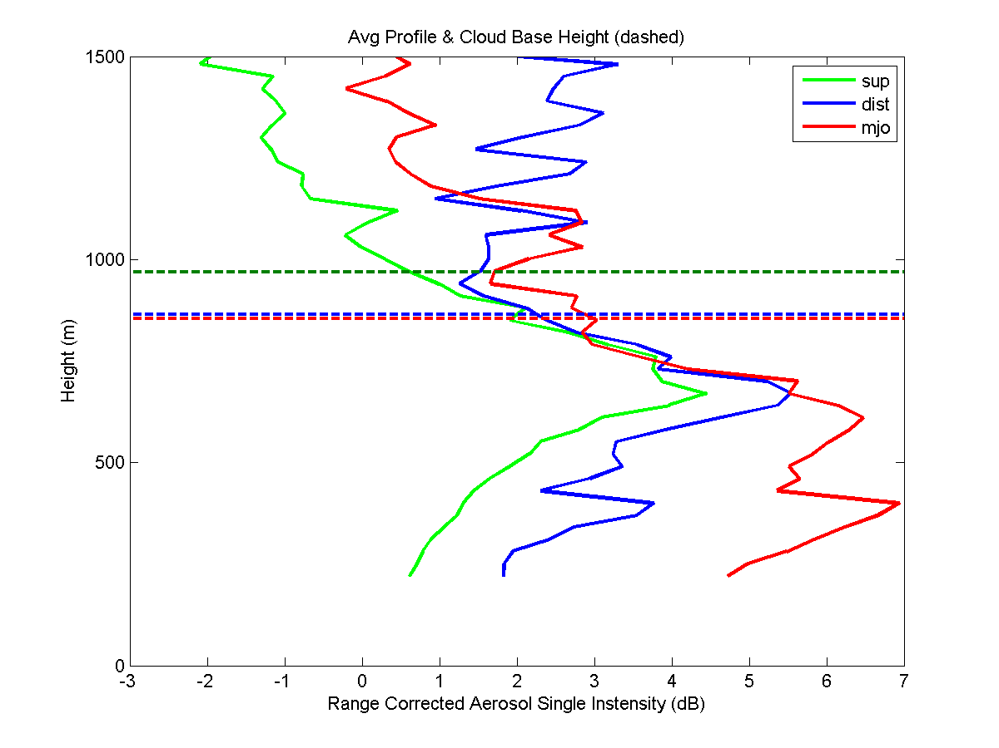
Aerosol Backscatter
Ceilo Cloud Base

Slide 35
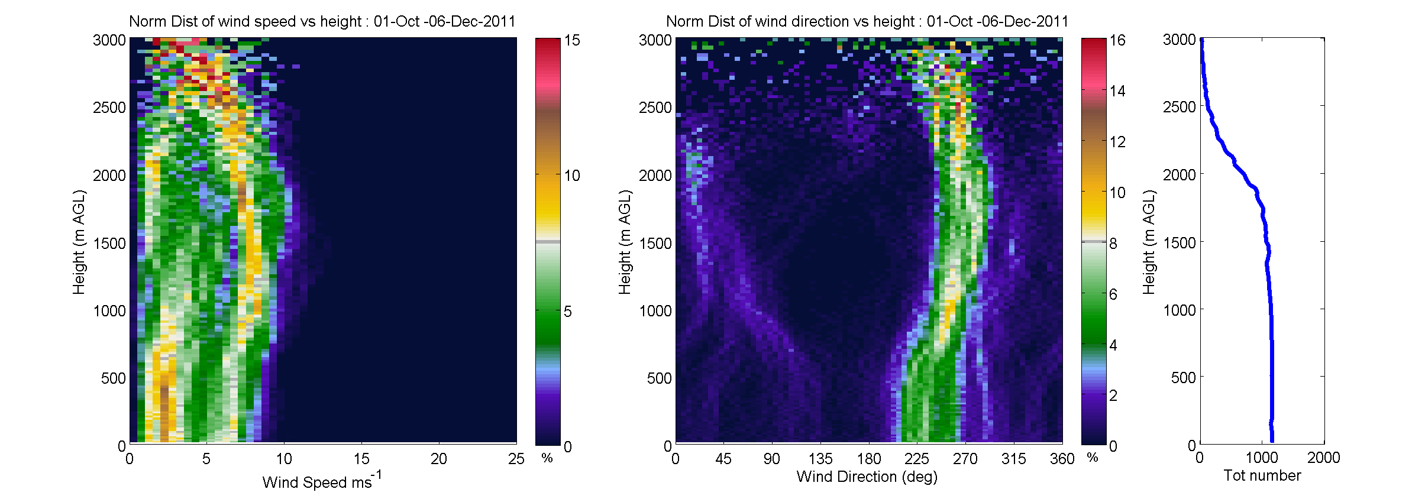
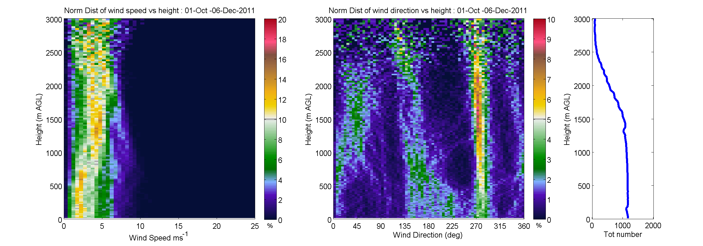
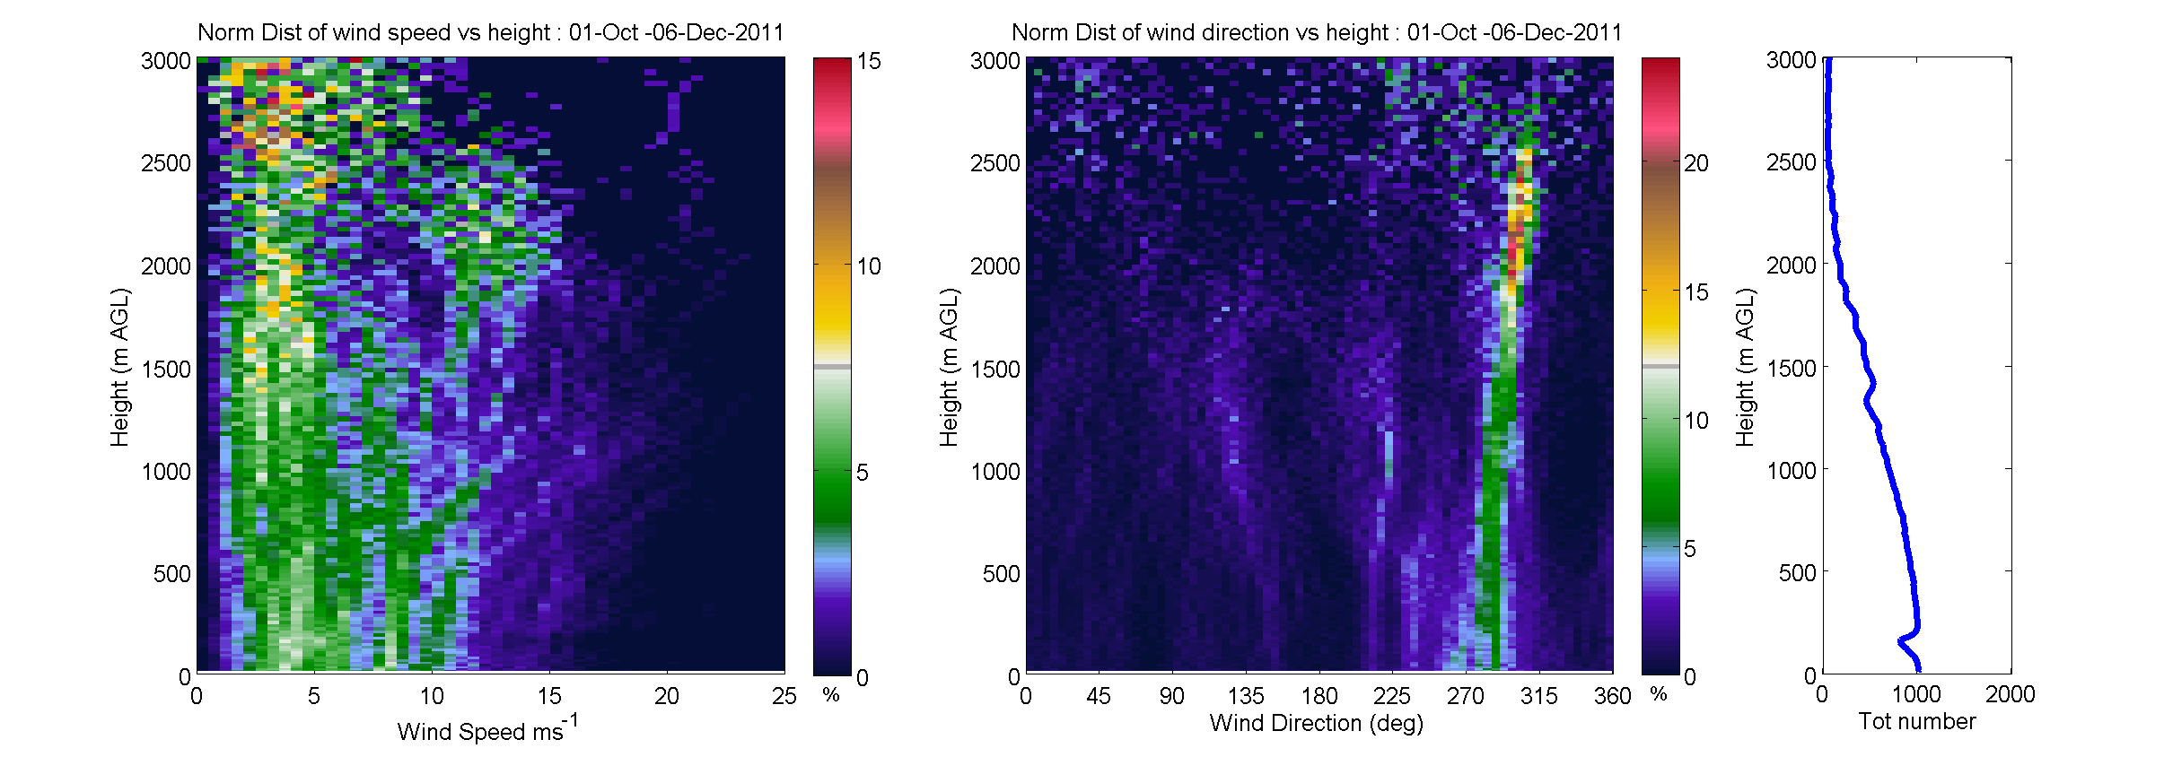
Wind profile distributions
Height (m)
Height (m)
suppressed
Speed (ms⁻¹)
Direction (deg)
Height (m)
Height (m)
disturbed
Speed (ms⁻¹)
Direction (deg)
Height (m)
Height (m)
active mjo
Speed (ms⁻¹)
Direction (deg)

Slide 36
Characterizing Convective Outflows
Provide contextual information for in-situ measurements
Creating a catalogue of over 350 outflows during legs 2&3
Strength/depth
Change in atmospheric properties across outflow
Airmass identification
Notes:
Here is the horizontal wind profiles for a 12 hour period during a day with a lot of structure. As we will show in the next slide, the 915 MHz profiler has issues with seaclutter below 1000m (the horizontal line) and the lower 200m is of particular interest when looking at air sea interaction.

Slide 37
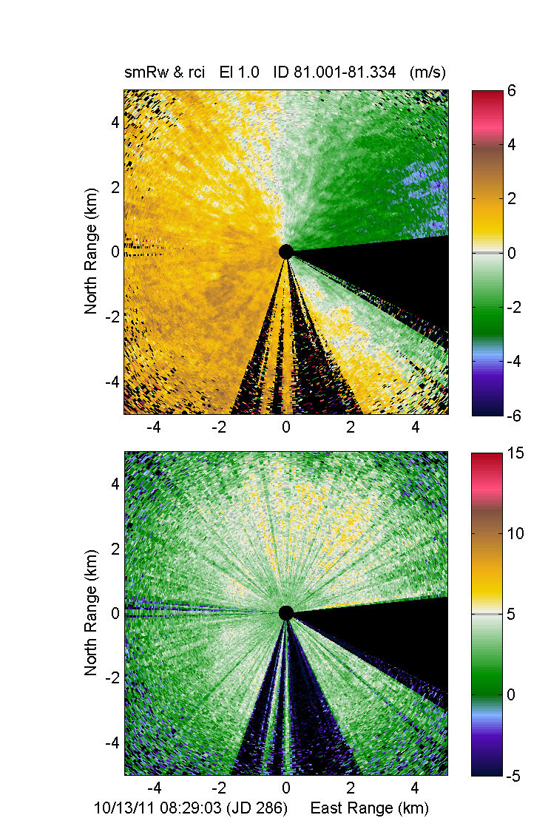
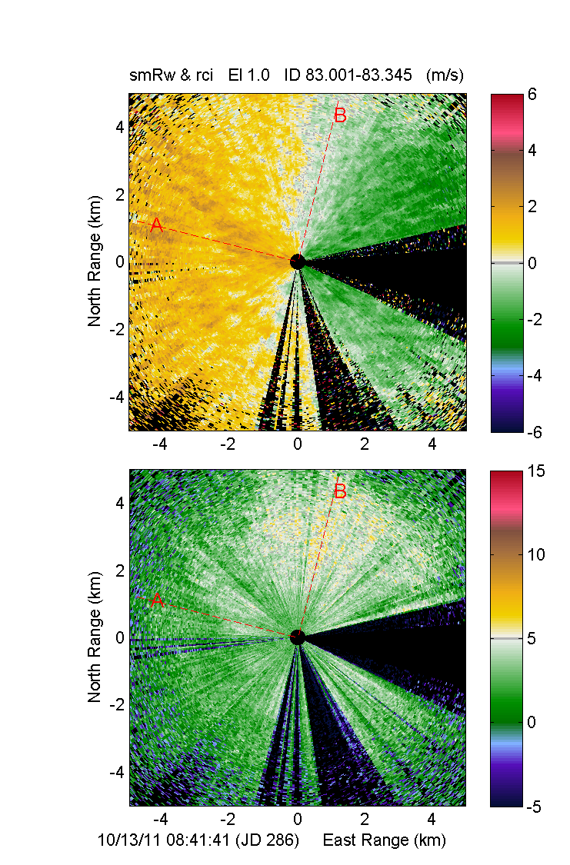
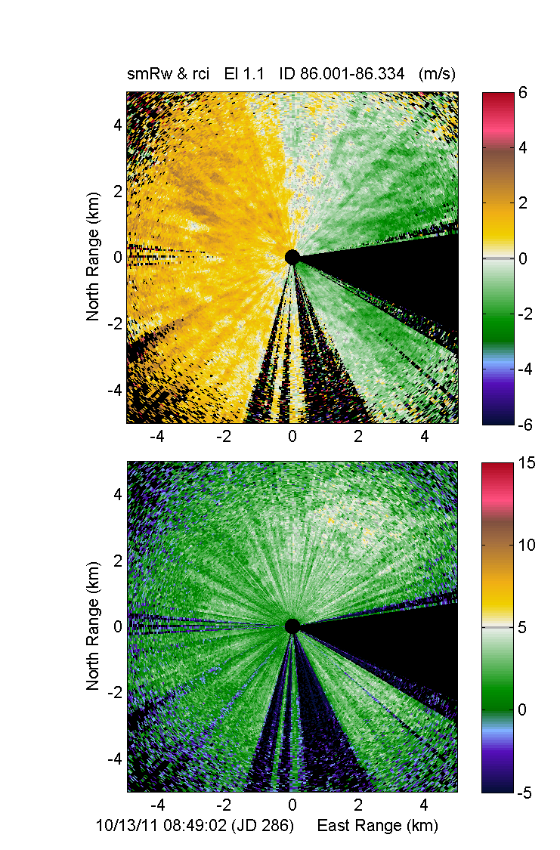
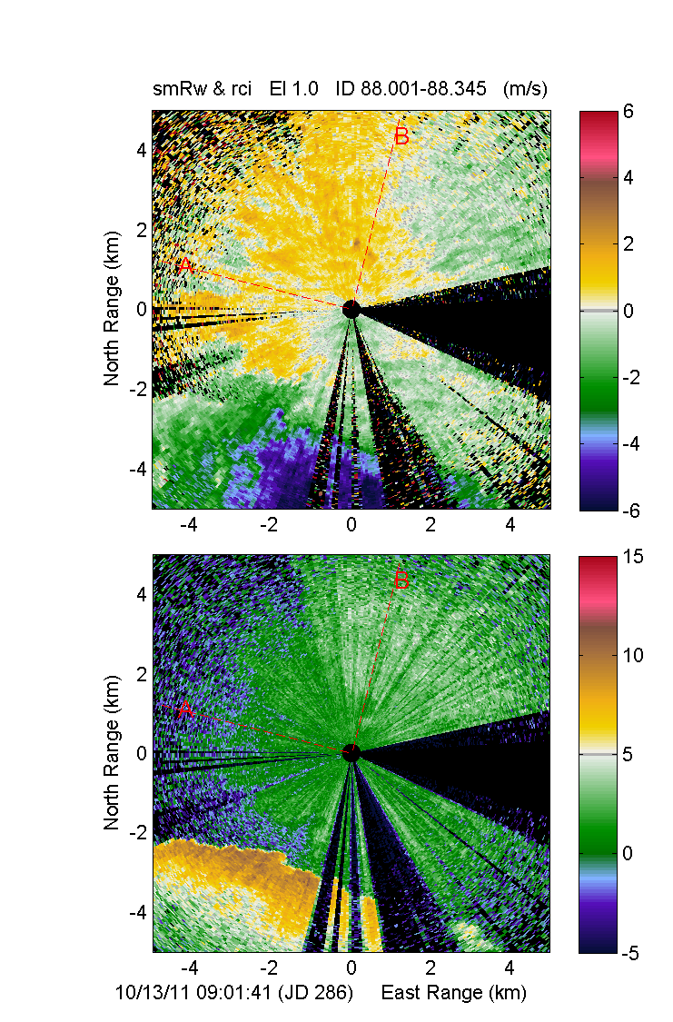
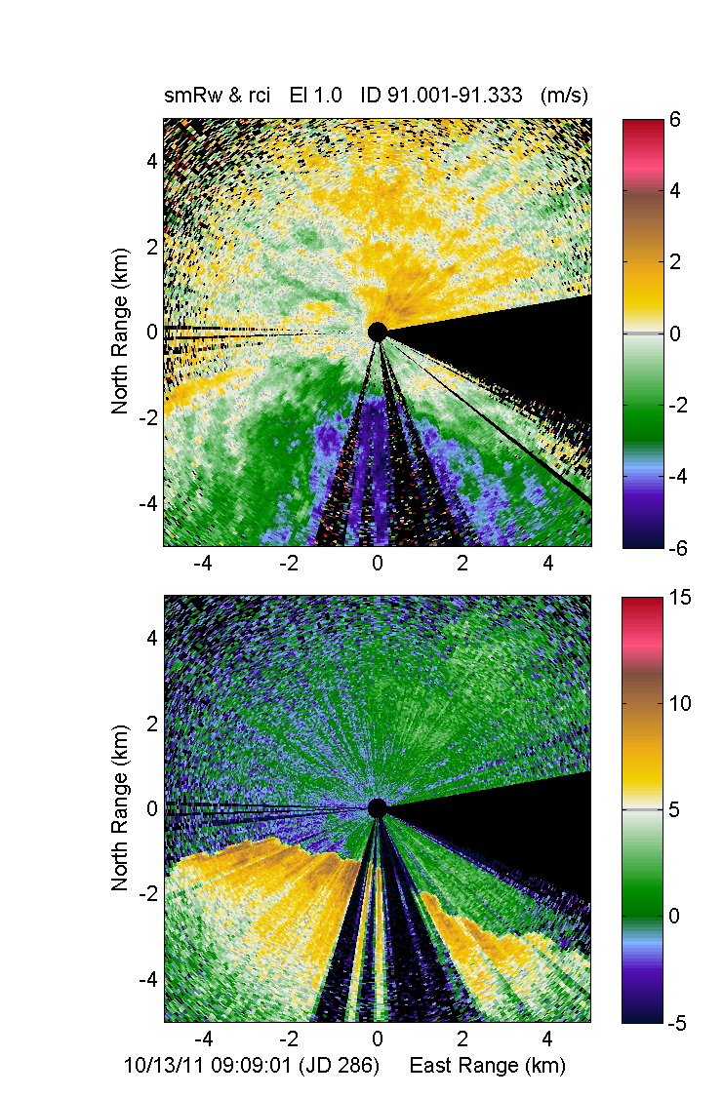
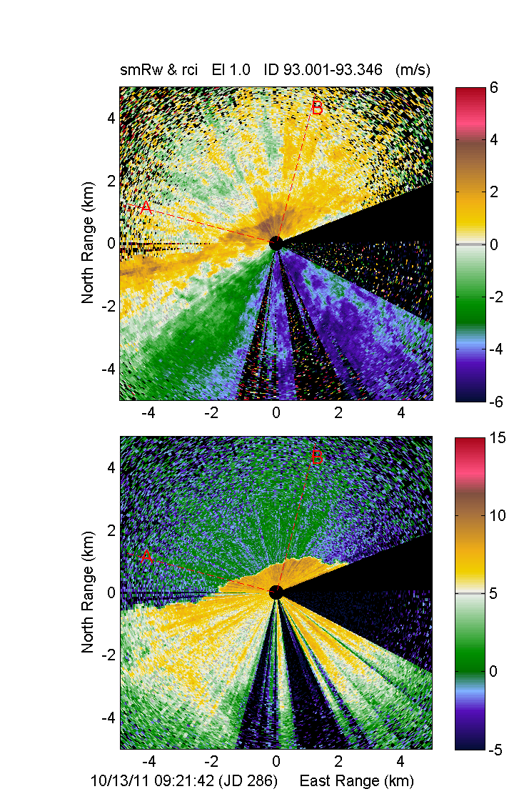
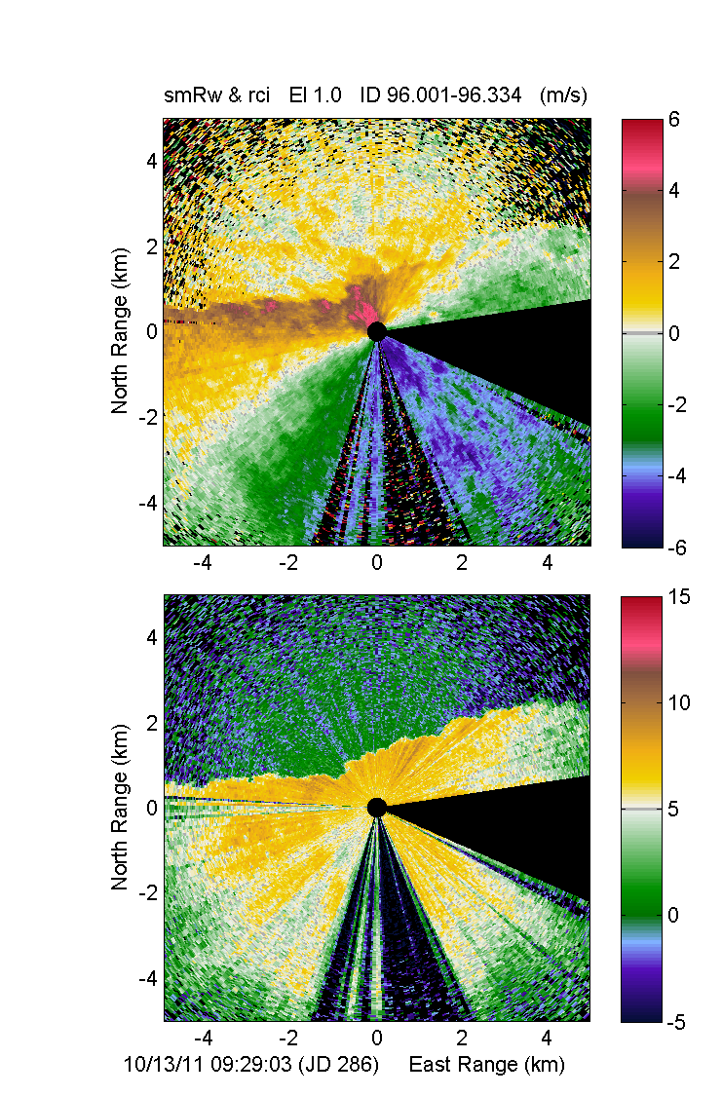
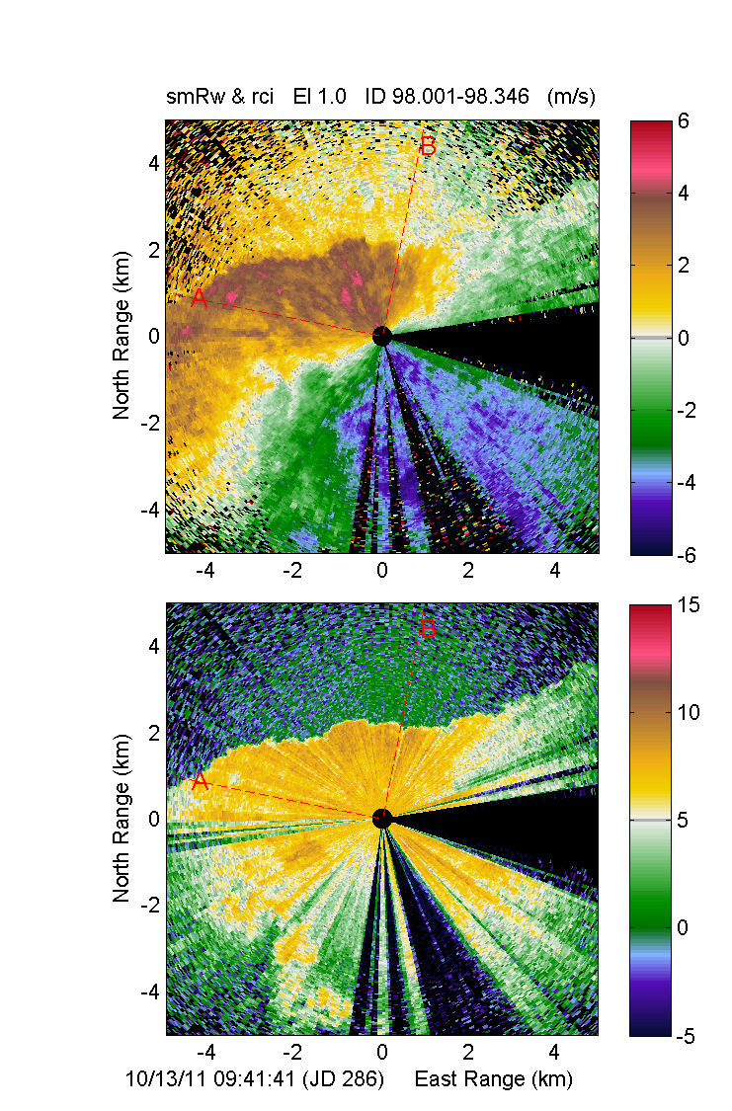
Residual Line-of-Site Velocity
Aerosol Backscatter
10 Minute Time Steps

Slide 38





Velocity
Horizontal
Vertical
Velocity
Intensity
Velocity along (B)
Intensity along (B)
Change in wind speed vs Height
Wind speed vs Height
All distances in km
Using low angle scans to study the surface layer :
Precipitation driven outflows
The velocity and aerosol backscatter enhancement can be tracked by the lidar
In both the horizontal and vertical planes
Height (km)
Height (km)
and also in other measurements made on the ship : thermodynamic and aerosol concentration and scattering
-4 -3 -2 -1 0 1 2 3
Wind speed (m/s)
Wind speed (m/s)
Black line 4 Hr avg
The depth and strength of the outflow can be characterized
by its effect on the wind profile
Notes:
We use the lidar, together with other measurements from the ship, to identify and characterize the strength and vertical and horizontal extent of density currents from precipitation driven outflows. (best viewed in slide show mode)

Slide 39

Summary
HRDL operated continuously (>98% uptime & 1350Hrs for Legs 2&3) during DYANMO.
Provide information on horizontal winds, turbulence and resolved spatial and temporally evolving wind fields
Forming distributions and statistics from these results as a function of convective regime
Creating a catalogue of convective outflow properties

Slide 40


Slide 41



Raul Alvarez and Ann Weickmann
Who lives in a MJO under the sea ?

Slide 42


Scott Sandberg
and for getting us on the ship …

Slide 47

Horizontal wind profiles
Height (m)
Speed
Height (m)
Direction
Leg 2 Leg 3
Continuous coverage, every 20 minutes
5-15m vertical resolution
From 5m up through top of aerosol layer or cloud base

Slide 48

Normalized Distributions
Height (m AGL)
Height (m AGL)
Speed (m/s)
Direction (deg)
Number
Combining on-station winds from Legs 2 & 3
Wind speeds where generally below 12 m/s from the surface through 3000m
Wind were generally out of the W/SW below 1000m with a tighter distribution (more westerly) up to 2500m
We form these distributions for different regimes found during the time on station

Slide 49

Local Solar Time Composite
Vertical Velocity Variance and Skewness
Combining on-station turb profiles from Legs 2 & 3
Vert peaks during evening and afternoon
Mixing is bottom up in the lower BL and top down near cloud base

Slide 50

Local Solar Time Composite
TKE and Isotropy Ratio
Stronger TKE in the local afternoon, vertical variance most important mid BL during the days
We form these composites for different regimes found during the time on station

Slide 51

Lidar – Sonde Comparison
Height (m AGL)
Wind speed Diff (Sonde–Lidar) (m/s)
For all 3hr Sonde profiles Legs 2 & 3 (RAW/UNPROCESSED)
Form mean(Sonde - Lidar) ± 3σ_{m} at every height

